Slide 1
East School Social Media
Presentation Summary
Officer Walden presented to the East Elementary PTO on Tuesday, January 23 on the topic of Social Media. The intent was to provide information to parents/guardians about the impact of social media and to provide some fundamental information about the popular applications that are being used by adolescents today. The following slides are from Officer Walden’s presentation, but selected slides have been removed because they require an explanation in order to put the information in context. Please review the information and access the various resources that are listed on the References for Parents slide near the end.
The internet is an invaluable tool to bolster our children’s education, but does present unique challenges to parents/guardians because of the ease of access to information and images that adolescents cannot put into context. The most important tool in supporting your child as they navigate the world of technology is open and frequent communication. You know your child best and don’t hesitate to act if you feel that your child is experiencing difficulty or confusion. Please contact us if you have any questions and we can work with you to address your questions and concerns.

Slide 3
Notes:
How many of you have heard about cyberbullying? What do you know about it?
(Pause for audience response.)
Cyberbullying is exactly what it sounds like - bullying through technology like cell phones, social media sites and online games. Research tells us that:
About 25% of middle and high school students have been cyberbullied. ⁹
About 16% admitted to cyberbullying others.
Youth who identify as gay, lesbian, bisexual or questioning are more likely to be involved, both as a victim and a bully.¹⁰

Slide 4
“Bullying”, the repeated use by one or more students of a written, verbal or electronic expression or a physical act or gesture or any combination thereof, directed at a victim that: (i) causes physical or emotional harm to the victim or damage to the victim’s property; (ii) places the victim in reasonable fear of harm to himself or of damage to his property; (iii) creates a hostile environment at school for the victim; (iv) infringes on the rights of the victim at school; or (v) materially and substantially disrupts the education process or the orderly operation of a school. For the purposes of this section, bullying shall include cyber-bullying.

Slide 5
“Cyber-bullying”, bullying through the use of technology or any electronic communication, which shall include, but shall not be limited to, any transfer of signs, signals, writing, images, sounds, data or intelligence of any nature transmitted in whole or in part by a wire, radio, electromagnetic, photo electronic or photo optical system, including, but not limited to, electronic mail, internet communications, instant messages or facsimile communications.
Cyber-bullying shall also include (i) the creation of a web page or blog in which the creator assumes the identity of another person or (ii) the knowing impersonation of another person as the author of posted content or messages, if the creation or impersonation creates any of the conditions enumerated in clauses (i) to (v), inclusive, of the definition of bullying. Cyber-bullying shall also include the distribution by electronic means of a communication to more than one person or the posting of material on an electronic medium that may be accessed by one or more persons, if the distribution or posting creates any of the conditions enumerated in clauses (i) to (v), inclusive, of the definition of bullying.

Slide 6
Notes:
As you can see, cyberbullying can have a tremendous impact on children. That’s why it’s so important for you to understand the issue. To combat cyberbullying, you need to know who is involved. Here are the major players:
Cyberbully - can be someone who instigates the bullying or someone who joins in.
Victim - the one being bullied, usually both online and offline.
Bystanders - those who stand by and watch the cyberbullying happen, but do nothing.
Your child may fall in at least one of these categories, sometimes more than one because many children who are cyberbullied also cyberbully others. They have also probably been bystanders at one point or another. Let’s talk about how to address children in each of these categories.

Slide 7
Notes:
Some examples of cyberbullying include:
Sending someone mean texts.
Photoshopping or altering a picture to embarrass someone.
Creating a fake profile to post defamatory information or images.
Posting fight videos online to embarrass the person who lost.
Spreading rumors and gossip online.
Posting pictures intended to embarrass someone.
Sending threatening or harassing comments.
Even young children who don’t use social media or cell phones can experience some form of cyberbullying while playing online games or playing in a virtual world. For example, they may be:
Exposed to inappropriate language while chatting.
Taunted by other players.
Targeted by more experienced players.
Ignored by other players or excluded from playing.

Slide 8
Notes:
Sometimes parents don’t find out that their children are cyberbullying others until they hear about it from another parent or from the school. Be proactive and look for these signs.
Your children may be involved with cyberbullying if they:¹⁶
Quickly switch screens or close programs when you walk by.
Use the computer at all hours of the night.
Get unusually upset if they cannot use the computer.
Laugh excessively while online.
Avoid discussions about what they are doing.
Use multiple online accounts or use an account that is not their own.
If you notice any of these behaviors, get involved and ask them to show you what they’re doing.

Slide 9
Notes:
Because cyberbullying can be so far reaching, it greatly impacts its victims. If your child is being cyberbullied, he or she may:
Suddenly stop using the computer or cell phone.
Act nervous when receiving an email, IM or text.
Seem uneasy about going to school.
Withdraw from friends and family.
If you see any of these signs, don’t ignore them. Cyberbullying victims need to feel that you are taking the problem seriously and that you are going to do everything that you can to help.

Slide 10
Notes:
Cyberbullying differs from regular bullying in a number of ways. It:
Often spreads faster than in-person bullying because of instant online communication.
Has a wider audience because it can easily be sent to a potentially unlimited amount of people.
Follows children home from school so they can’t get away from it.
All of this can undermine your child’s sense of security. They don’t feel a safe at school – because cyberbullies are frequently classmates and other peers – and they don’t feel safe at home because the bullying is happening 24/7 online.

Slide 11
Notes:
Most kids are not bullies or victims; they are bystanders. They are afraid to speak up about cyberbullying because they’re afraid of being targeted next or being called a tattletale. However, information from bystanders is critical if teachers and other trusted adults are to take action.
Talk to your child about not being a bystander. You can do this by:
Establishing expectations for reporting - Make sure they understand that you expect them to speak up when they see cyberbullying happen because silence only lets it continue.
Encouraging them to stand up for the victim when they feel it’s safe to do so - That might mean being a good friend to the victim, telling the bully to stop or refusing to join in the cyberbullying. They can also show support to the victim in private.
Helping them report the cyberbullying to the website where it is taking place or to a trusted adult at school - Bystanders will feel better about reporting if they are reassured they’re doing the right thing, so help them see it through.

Slide 12
Notes:
To help prevent your child from becoming a cyberbully, you can:
Establish expectations for online behavior - Make sure your child knows that you think bullying and cyberbullying are unacceptable.
Set consequences for cyberbullying - This will vary by family, but can include losing Internet privileges or more supervised Internet use.
Model good online behavior yourself - Children learn from the adults around them, so always be respectful of others online.
You don’t have to tell your children that they have to be friends with everyone, but you should teach them about respecting others. If you find out that your child has already been involved in cyberbullying, be open to working with the school as they look to correct the problem.

Slide 13
Notes:
Here are some specific ways you can help if your child is a victim of cyberbullying:
Consider saving the evidence – Ask the school or the police about taking screenshots and printing out any messages. If there is an investigation, they may want to see proof of what was posted.
Block cyberbullies – Tell your child not to respond to the messages and take advantage of website features that allow you to block any user who is bothering you.
Set up new accounts - This includes email, IM, social media sites and cell phone numbers. Make sure they only give the new information to friends they trust.
Talk to the school - Remember, most cyberbullying involves in-person bullying by someone your child knows, usually a classmate. Teachers and administrators should work together on a plan to address the bullying in school, and they may have specific rules against cyberbullying, too.
Report it to the website or app where the cyberbullying is taking place - You might also be able to report unwanted text messages to your cell phone provider and block certain numbers. If you feel that any laws have been broken or if your child has been threatened, then contact the police for help.
Finally, remember to take your child seriously. Don’t use phrases like, “Kids will be kids.” Bullying can be very painful. Comfort your child by offering your support and understanding.

Slide 14
Notes:
Here’s what you can do to help prevent your child from posting inappropriate information online:
Establish expectations for online behavior – Let them know exactly what you think is unacceptable. For very young children, this might be limited to what websites they are allowed to go on and for how long, but for older children it might include what websites and apps they can use, how long they can use them, who they talk to, what they post, and more.
Set consequences for inappropriate posts - Remind them that they can also face consequences at school and with the law.
Talk about appropriate usernames - This is especially true for younger children who play in virtual worlds or any children who play games online. Usernames shouldn’t contain offensive language or violate the game’s rules.
Review comments and pictures - Check out what they’re posting and ask them to take down anything inappropriate.
Talk about what their friends are posting - Sometimes what your children’s friends post can reflect poorly on them, too, so look at their friends’ posts and discuss them if needed.

Slide 15
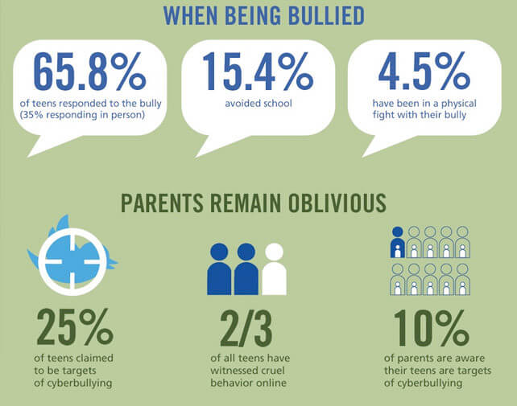

Slide 16
76 percent of American teens age 13-17 use Instagram.
75 percent of teens use Snapchat.
66 percent of teens use Facebook
47 percent of teens use Twitter.
Fewer than 30 percent of American teens use Tumblr, Twitch, or LinkedIn.

Slide 17
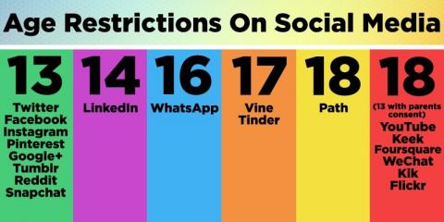

Slide 18
Teenager device usage:
54% have access a desktop
68% have access to a tablet
80% have access to a laptop
89% have access to a smartphone

Slide 20
Managing other people on Instagram
While you can't control other people's behavior, you can control whether you want to deal with it. Instagram has released a few features to block comments with words or phrases you don't want to see.
To do this, head into your settings menu and find the “Comments” menu. Turn on the option to “Hide Inappropriate Comments,” which will filter out comments using commonly offensive words. Below that option, you should see a text box that lets you type in custom keywords, in case there's a particular word or phrase you want banned.

Slide 22
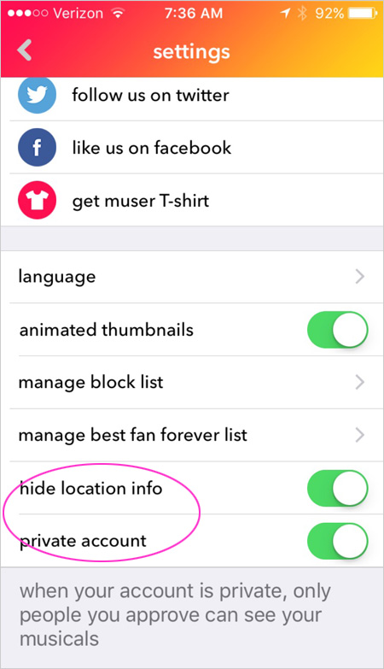
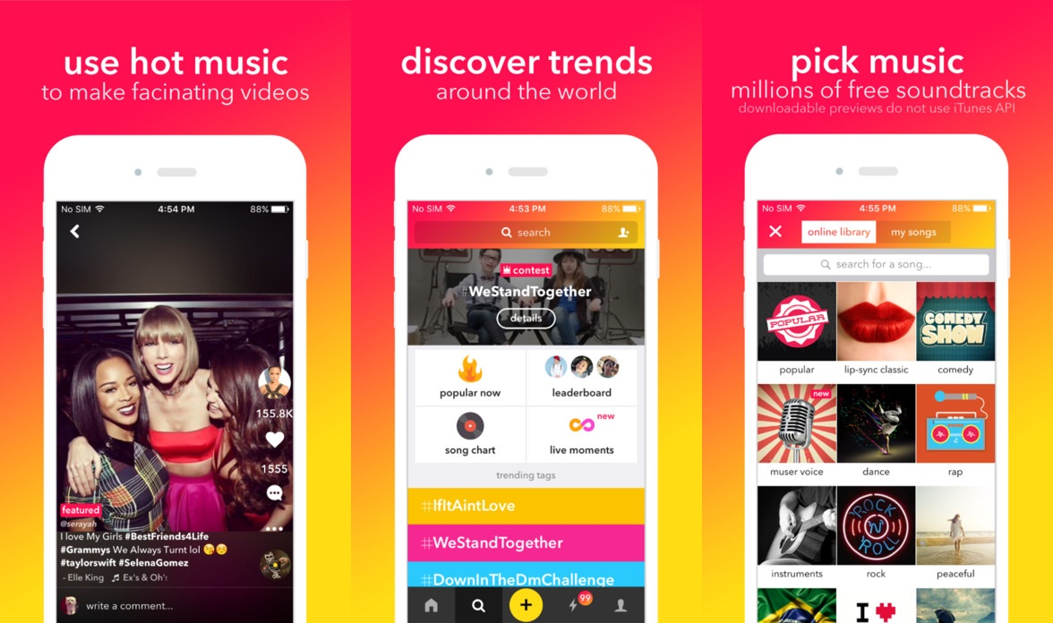

Slide 23
Game consoles can access the internet and allow teens to connect to anyone throughout the world. Some consoles also have cameras that allow for live streaming.

Slide 24
Negative effects of social media
Anxiety & depression:
Research suggests that young people who spend more than 2 hours per day on social media are more likely to report poor mental health, including psychological distress (symptoms of anxiety and depression).
Sleep: Numerous studies have shown that increased social media use has a significant association with poor sleep quality in young people. Using phones, laptops, and tablets at night before bed is also linked with poor quality sleep.
Body image: Body image is an issue for many young people, both male and female. Studies have shown that when women in their teens and early twenties view Facebook for only a short period of time, body image concerns are higher compared to non-users.
Cyberbullying: Bullying during childhood is a major risk factor for a number of issues including mental health, education and social relationships, with long-lasting effects often carried right through to adulthood.
Fear of Missing Out (FOMO):FOMO has been robustly linked to higher levels of social media engagement, meaning that the more an individual uses social media, the more likely they are to experience FOMO.

Slide 25
Positive effects of social media
Access to expert health info: Social networking offers young people who may be suffering from mental health issues an opportunity to read, watch or listen to, and understand, the health experiences of others – relating them back to their own reality.
Emotional support: Conversations on social media can emerge and provide young people with essential interaction to overcome difficult health issues, particularly when they may not have access to that support face-to-face.
Community building: The community building aspect of social media is also distinctly positive for many young people. By joining ‘groups’ or ‘pages’ young people can surround themselves with like-minded people and share their thoughts or concerns.
Self-expression: Self-expression and self-identity are important aspects of development throughout the teen years. Social media can act as an effective platform for positive self-expression, letting teens put forward their best self.
Building upon relationships: There is evidence to suggest that strong adolescent friendships can be enhanced by social media interaction, allowing young people to create stronger bonds with people they already know.

Slide 26
Who can explain what a “Cyber Predator” is?

Slide 29
Notes:
Personal information that your children shouldn’t share online includes their:
Passwords.
Home address.
Location.
Home/cell phone number.
Email address.

Slide 31
Wireless Routers with parental controls

Slide 32
Devices such as the Circle from Disney can allow parents/guardians to control access to the wifi signal. However, it does not control access through a cell phone signal.

Slide 34
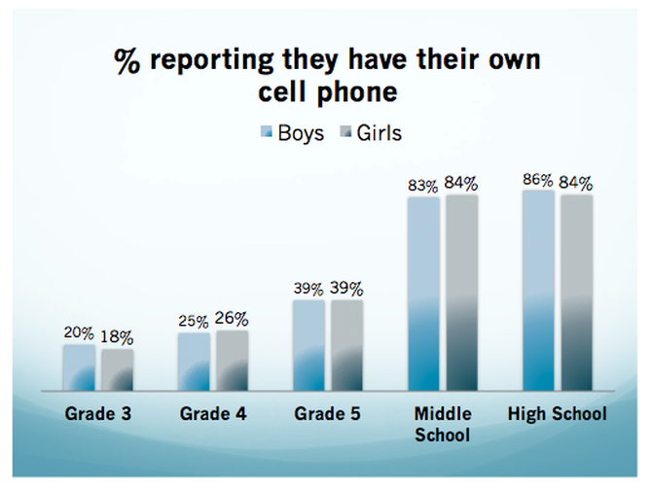

Slide 38
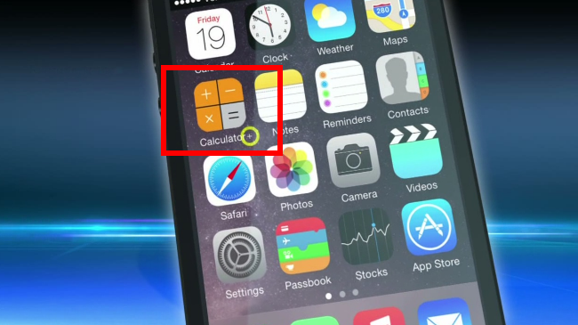
There are fake app icons that can be used to hide other apps. A calculator icon is commonly used to hide apps and other folders on a smartphone.
BAD!

Slide 39
Notes:
You’ve now heard several strategies to help you deal with inappropriate content, online privacy, sexting, online sexual solicitation and cyberbullying. Most of those suggestions have been based on communicating with your children, but I also want to talk about technological solutions.
Here are some options you may want to look into:
Filtering and monitoring software - These can help protect your children from seeing sexually explicit content online and even notify you if they’re receiving inappropriate messages. NetSmartz does not endorse any particular kind of software, but you can go to www.getnetwise.org to search for the software that best fits your needs.
Consult your cell phone service provider - They may offer monitoring options for your child’s cell phone.
Research options for mobile devices – Laptops, tablets, handheld games and MP3 players may have built-in monitoring options or software for purchase.
Look at the individual apps they’re using - Many apps have the option to turn off chat features or limit who can see what your child posts within the app.
Explore built-in security features for programs and websites - These often have their own privacy or filtering services. For example, Google has a free SafeSearch option. Each website or app has different privacy and filtering settings, so you should consult each one to help you better understand their systems. A list of help centers can be found on the tip sheet “NetSmartz Tech Tips.” If you have specific questions, you can write to NetSmartz at www.NetSmartz.org/contactus.

Slide 40
REFERENCES FOR PARENTS
https://smartsocial.com/
http://www.netsmartz.org
https://www.commonsensemedia.org/social-media
https://emojipedia.org/
https://emojipedia.org/snapchat/
https://www.spyzie.com/parental-controls/iphone-parental-monitoring.html

Slide 41
You can contact Officer John Walden (jwalden@hinghamschools.org) if you have additional questions regarding information contained in the presentation. You can also contact Tony Keady (akeady@hinghamschools.org) if you have specific concerns about your child. It is important to connect with your child’s school if you have questions or concerns about any facet of your child’s experience at school.

