Slide 1
WELCOME TO HINGHAM HIGH SCHOOL
FEBRUARY 27, 2018

Slide 2
TONIGHT’S PROGRAM
RICK SWANSON, PRINCIPAL
JOE CAVANAUGH & KALEY JOHANNES, CLASS OF 2018
SARA ADER, HHS PTO
HEATHER RODRIGUEZ, DIRECTOR OF COUNSELING
JIM QUATROMONI, ATHLETIC DIRECTOR
Q & A

Slide 3
ESSENTIAL QUESTIONS
WHAT IS LIFE LIKE AT HHS?
HOW IS THE HIGH SCHOOL DIFFERENT FROM HMS?
HOW WILL I COMMUNICATE WITH THE SCHOOL?
WHAT IS THE ORIENTATION PROGRAM?
HOW CAN I GET INVOLVED?
OTHER QUESTIONS…

Slide 4
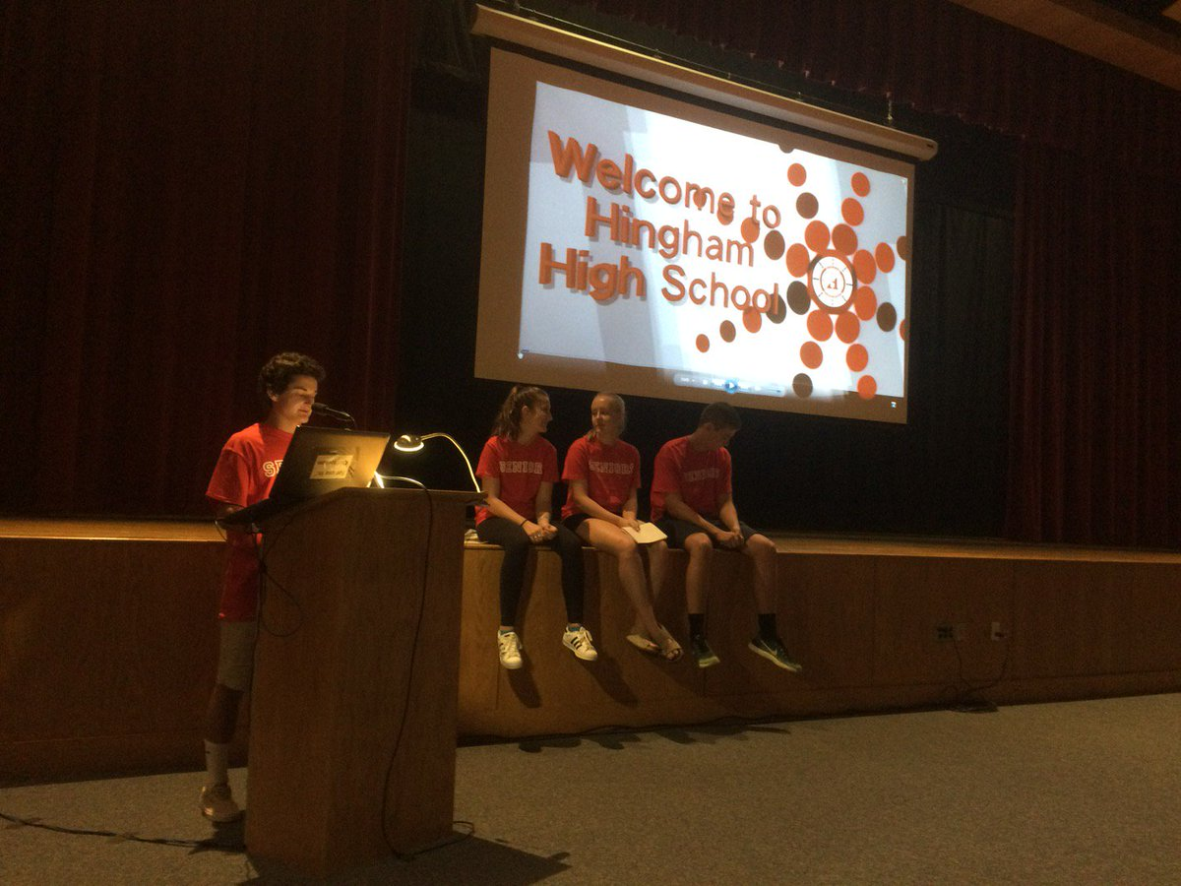
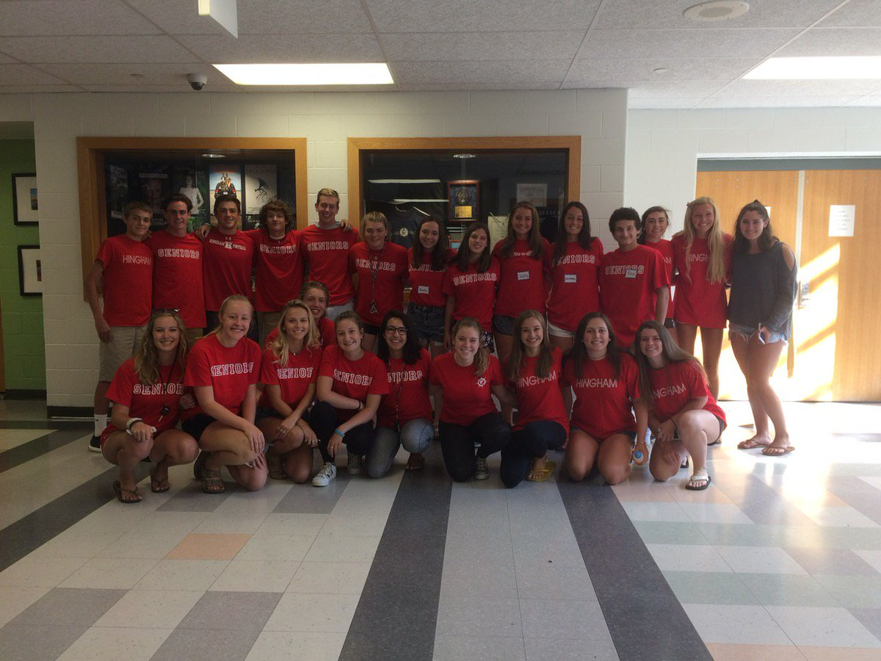
EMPOWERING STUDENT LEADERS… LIKE JOE & KALEY

Slide 5
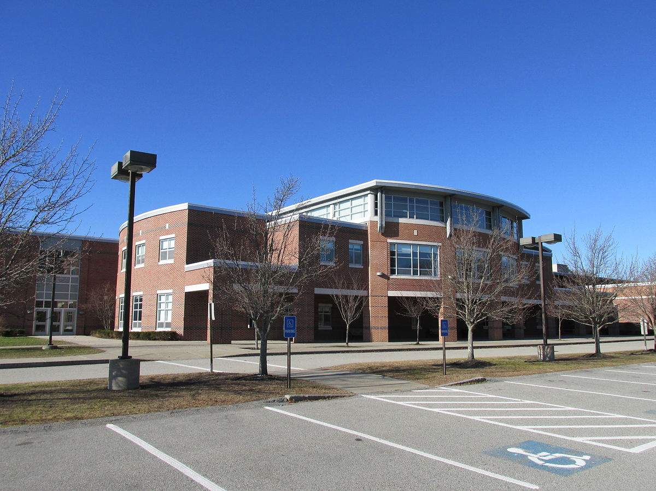
A FEW OTHER THINGS TO KNOW ABOUT HHS

Slide 6
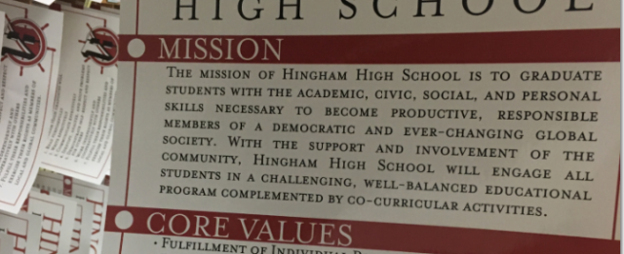
EVERYTHING WE DO ALIGNS WITH OUR MISSION…

Slide 7
…OUR CORE VALUES…
FULFILLMENT OF INDIVIDUAL POTENTIAL
RESPECT FOR SELF AND OTHERS
CIVIC RESPONSIBILITY
COMMITMENT TO LIFE-LONG LEARNING
ENVIRONMENTAL STEWARDSHIP
GLOBAL CITIZENSHIP

Slide 8
…AND OUR EXPECTATIONS FOR STUDENT LEARNING
ALL HHS GRADUATES WILL:
READ PURPOSEFULLY
WRITE EFFECTIVELY
COMMUNICATE EFFECTIVELY
IDENTIFY, ANALYZE AND SOLVE PROBLEMS
DEMONSTRATE SELF-RESPECT AND RESPECT FOR OTHERS

Slide 9
WE HAVE AN AMAZING PTO
HHSPTO.WEEBLY.COM

Slide 10
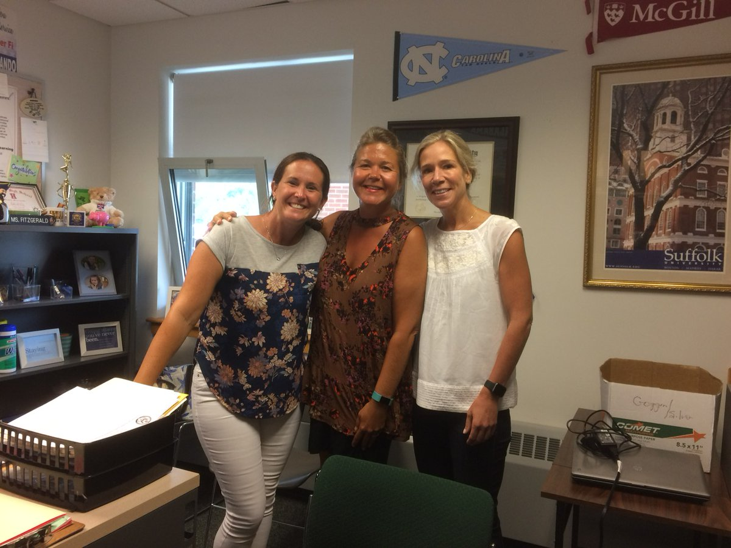
…AND TERRIFIC COUNSELORS
NOVEMBER 16-18

Slide 11
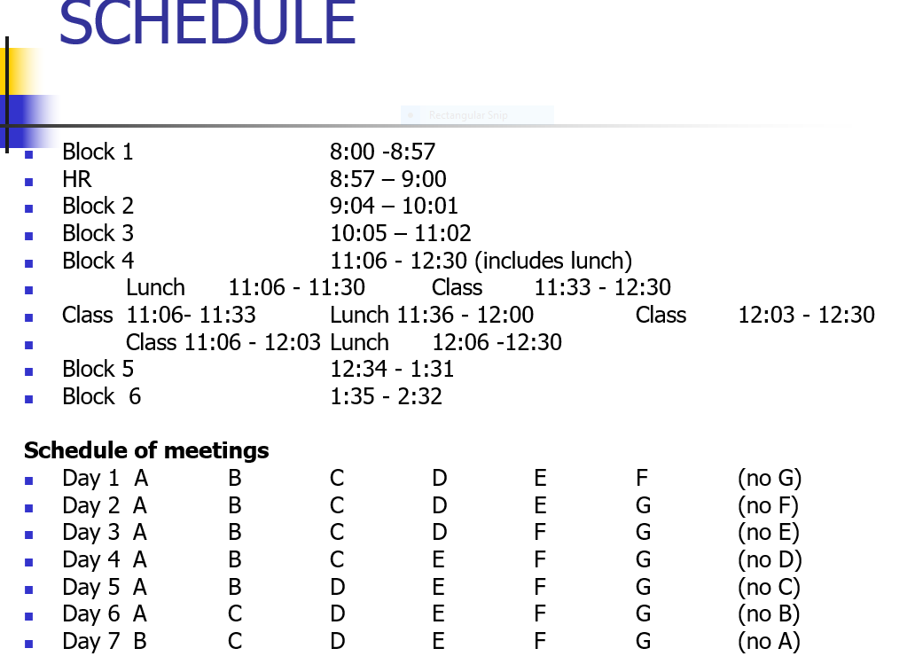
THE HHS SCHEDULE LOOKS DIFFERENT

Slide 12
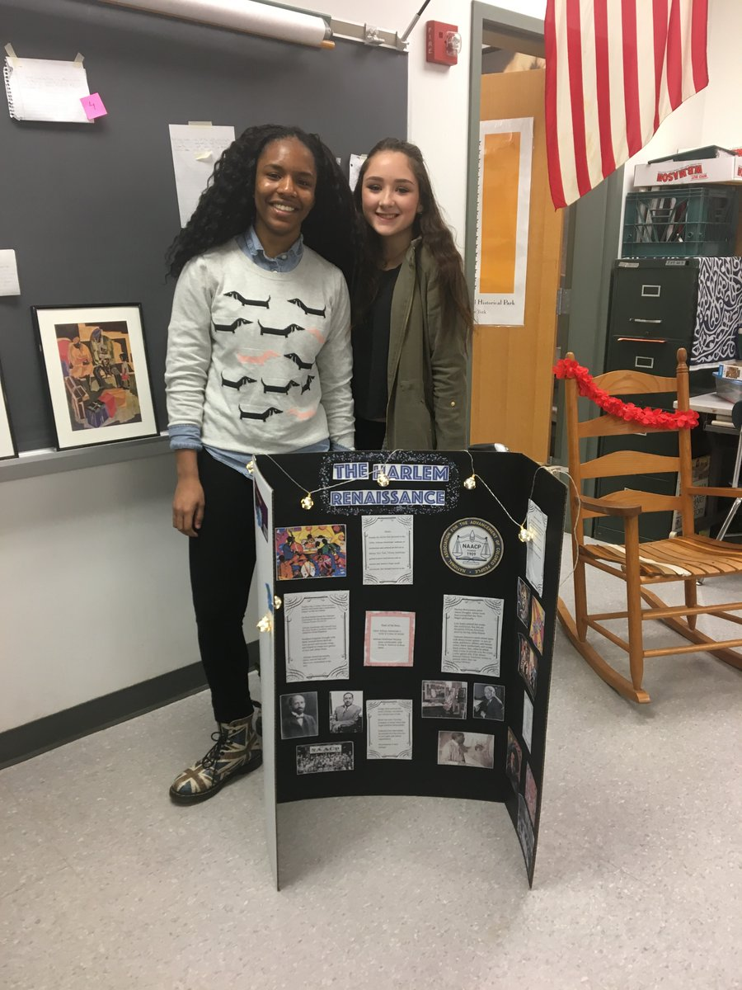
GRADUATION REQUIREMENTS – SEE THE PROGRAM OF STUDIES FOR DETAILS
HHSPTO.WEEBLY.COM

Slide 13
SUCH AS…
HHS GRADUATES MUST COMPLETE:
20 CREDITS IN ENGLISH
15 CREDITS IN MATH, SCIENCE & SOCIAL STUDIES
10 CREDITS IN THE SAME FOREIGN LANGUAGE
2.5 CREDITS IN FINE/APPLIED ARTS

Slide 14
TO EARN A DIPLOMA…
EVERYBODY MUST:
EARN 110 CREDITS
PASS THE MCAS IN ELA, MATH AND SCIENCE
AND ATTEND SCHOOL REGULARLY!

Slide 15
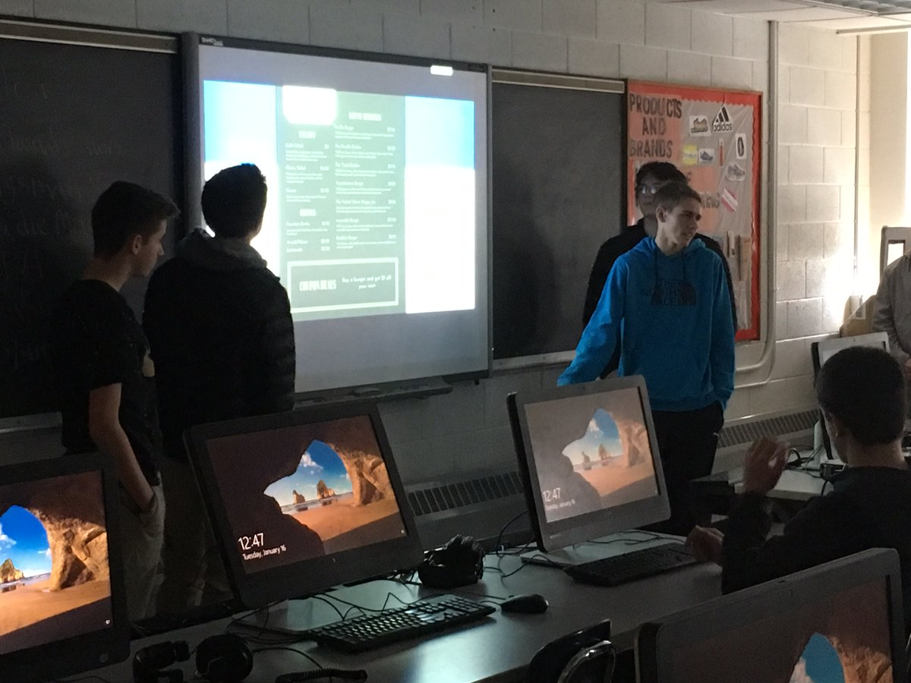
WIDE VARIETY OF ELECTIVES

Slide 16
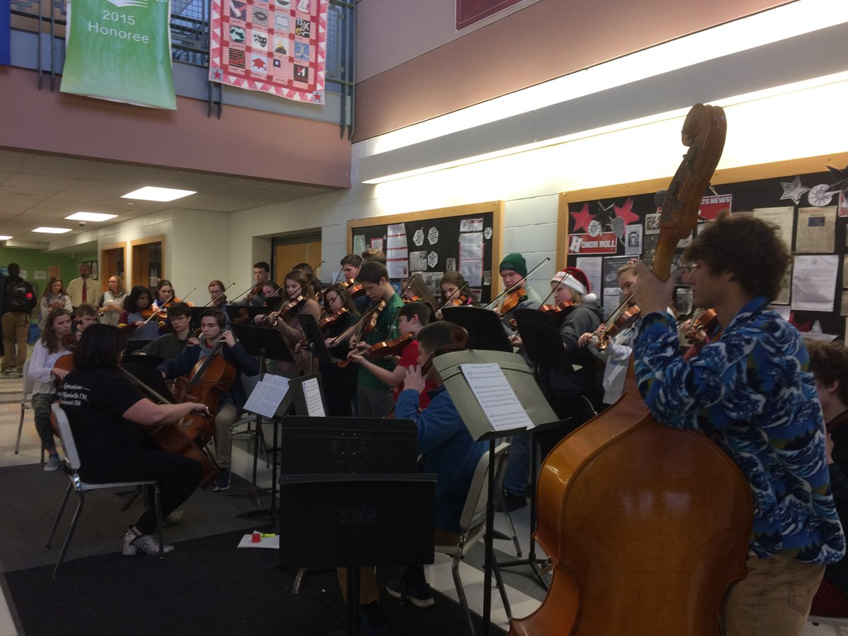
A VIBRANT MUSIC PROGRAM

Slide 17
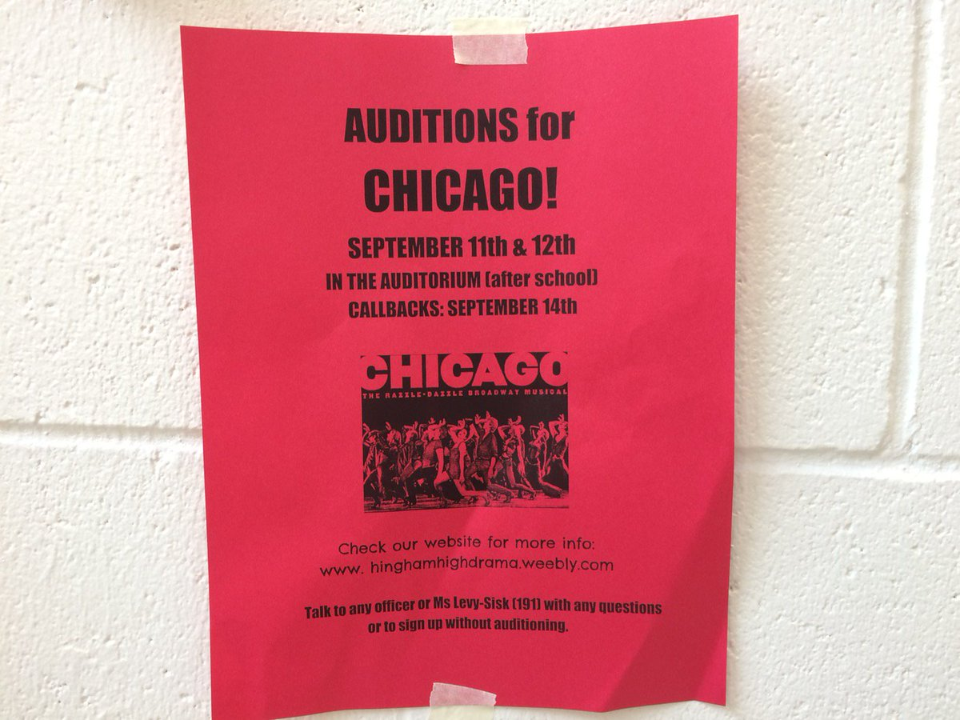
THE ARTS

Slide 18
THE INDUSTRIAL ARTS

Slide 19
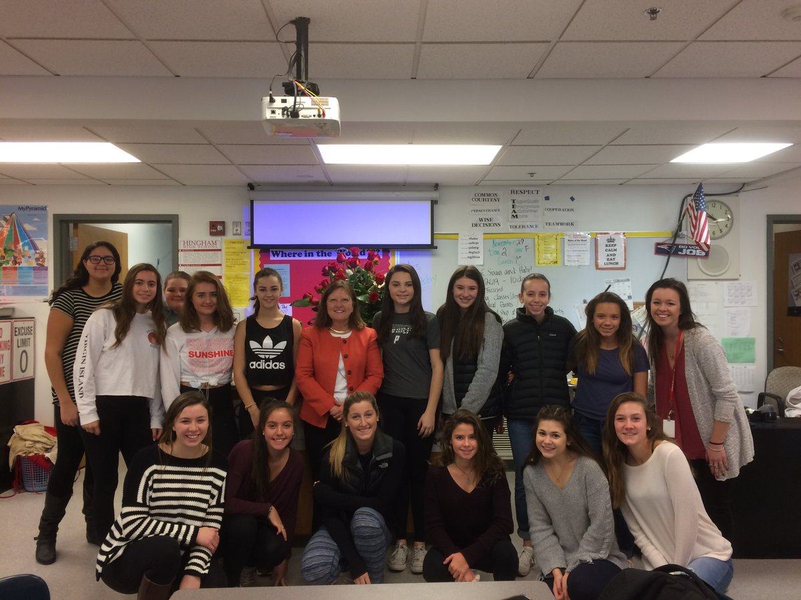
FAMILY & CONSUMER SCIENCES CONTINUE TO FLOURISH

Slide 20
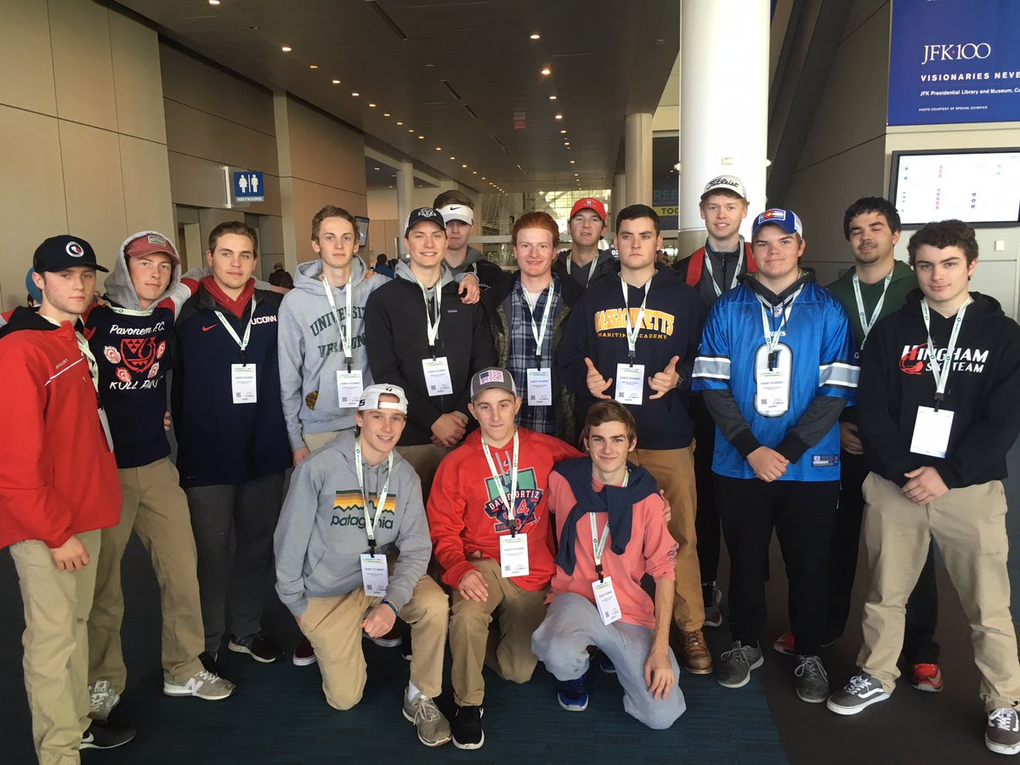
AS DO THE REGULAR SCIENCES – INCLUDING ELECTRONICS

Slide 21
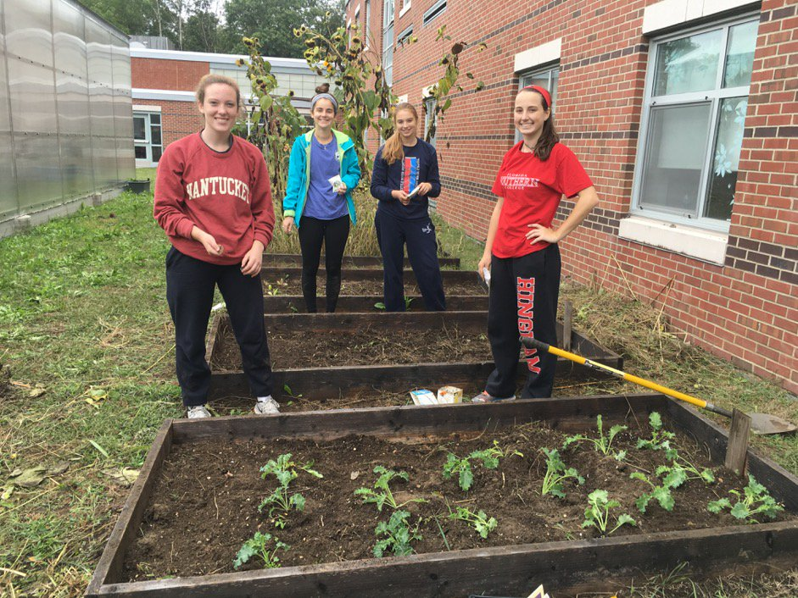
EVEN A GREENHOUSE (AND A BOTANY COURSE)!

Slide 22
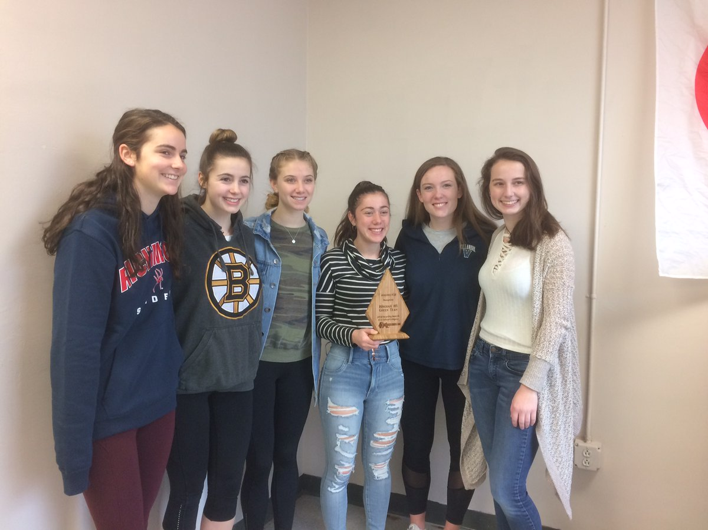
NUMEROUS AWARDS FOR SUSTAINABILITY

Slide 23
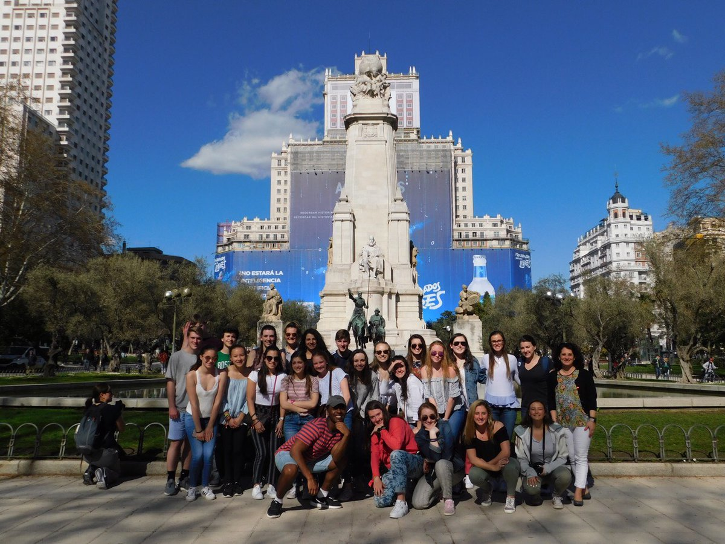
GLOBAL FOCUS

Slide 24
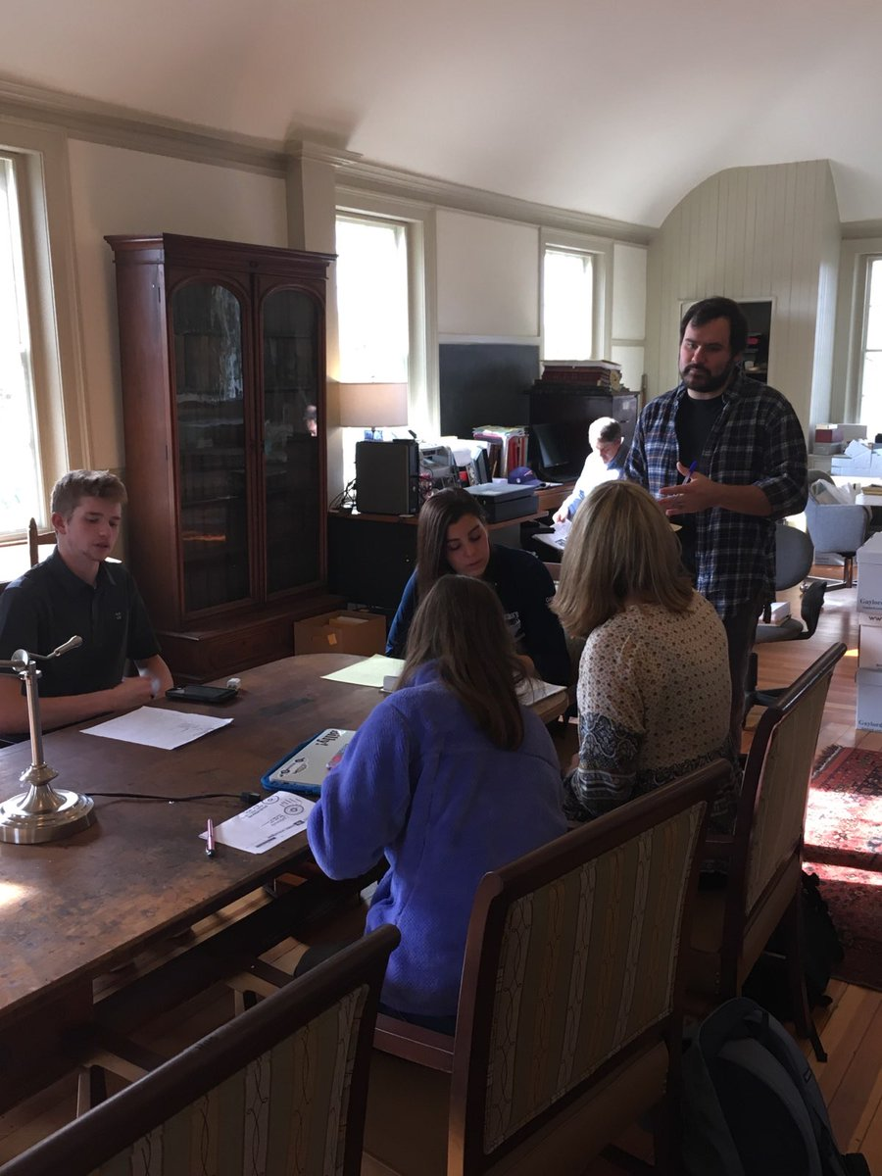
INTERNSHIP OPPORTUNITIES

Slide 25
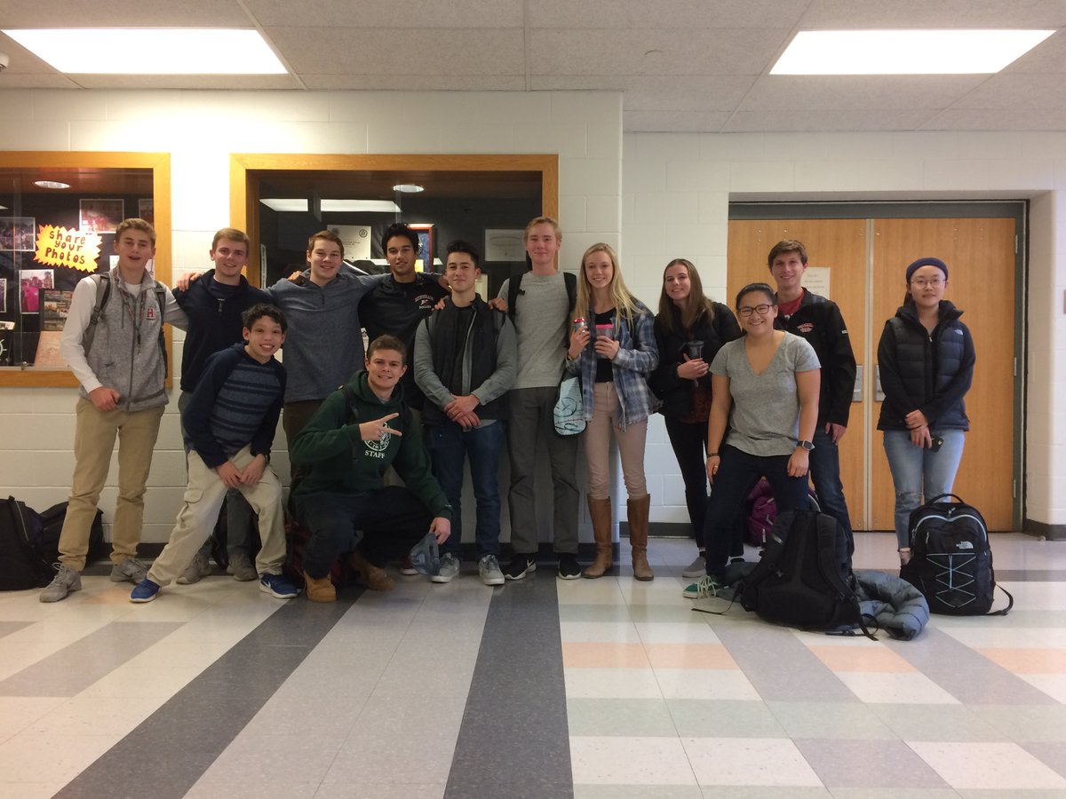
CLUBS GALORE

Slide 26
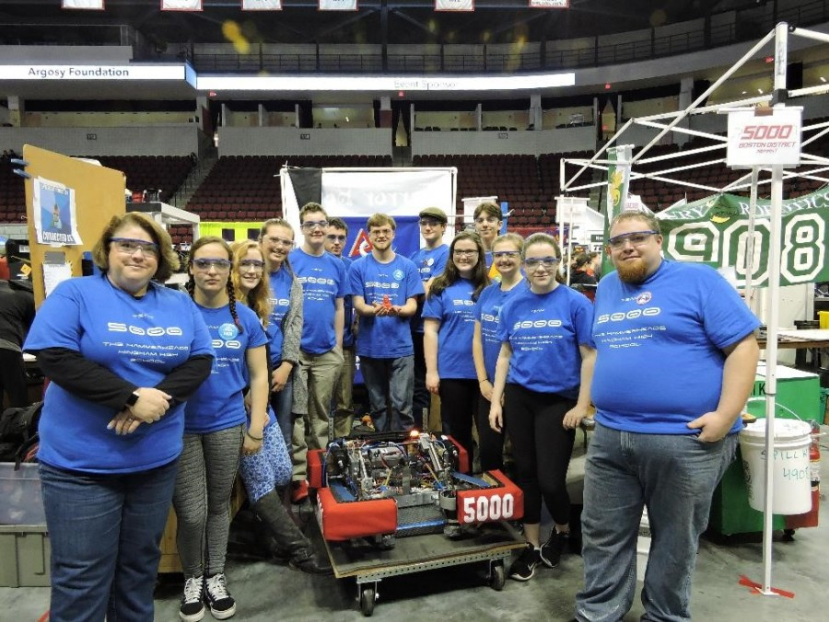
MANY WITH AN ACADEMIC FOCUS – SUCH AS… ENGINEERING AND ROBOTICS

Slide 27
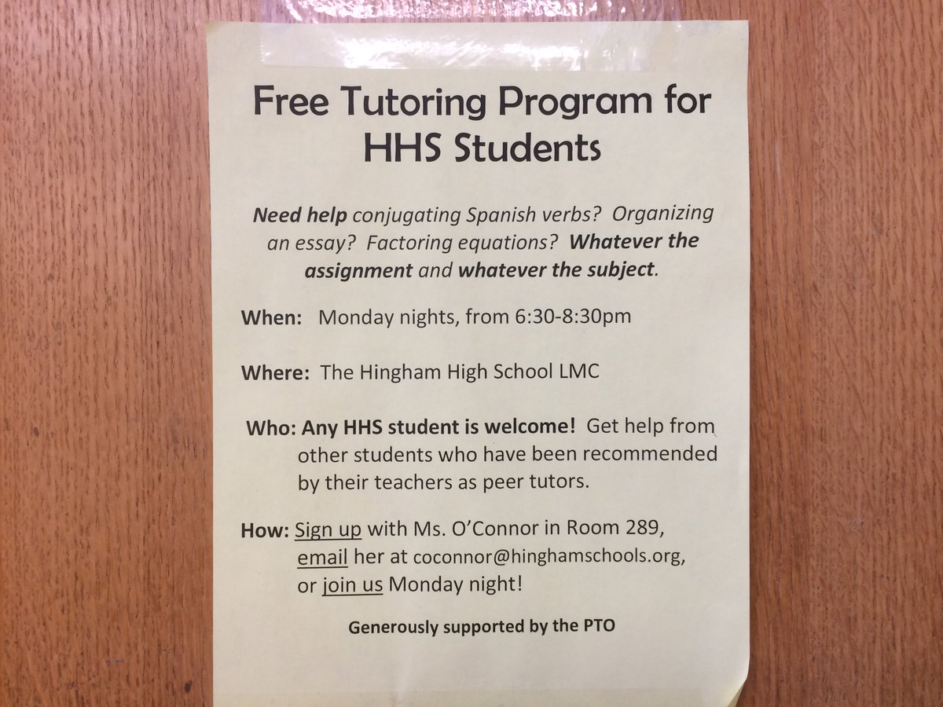
WE EVEN HAVE A HOMEWORK CLUB!

Slide 28
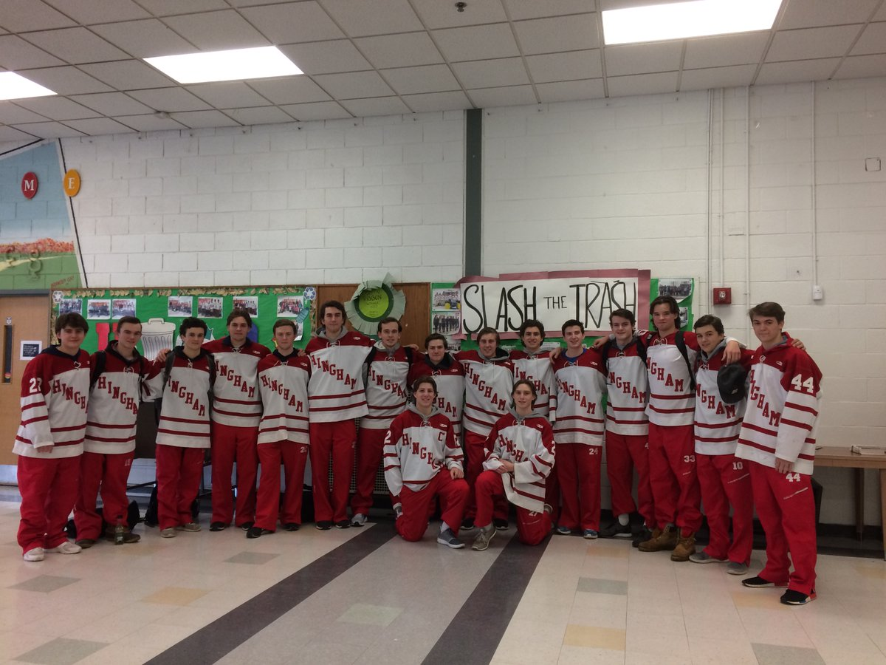
ROBUST ATHLETICS PROGRAM

Slide 29
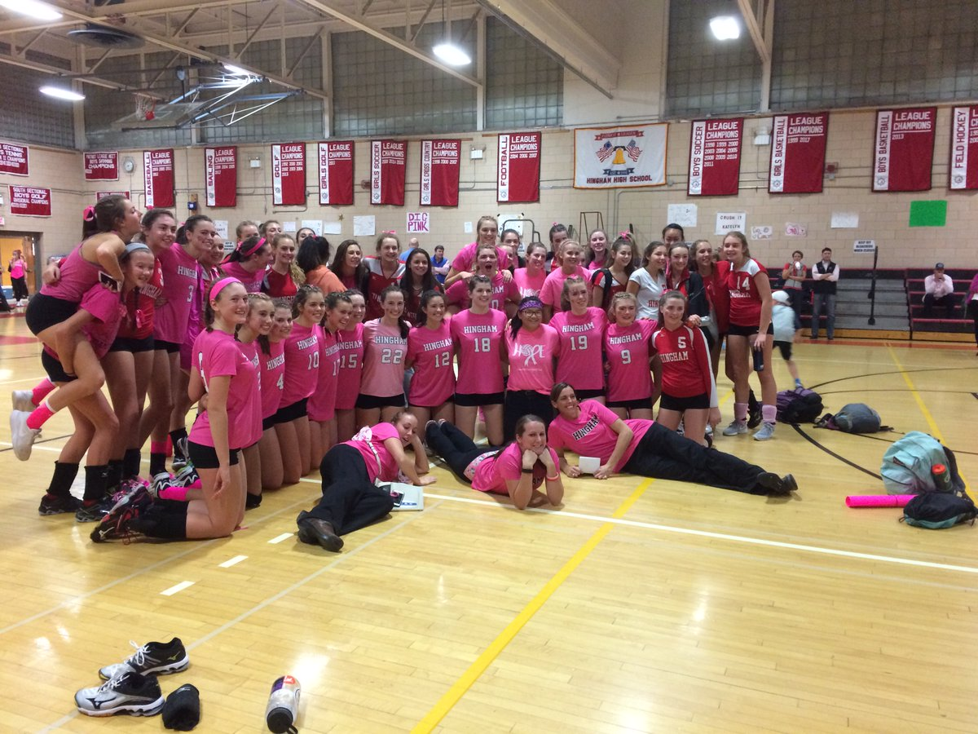
HHS TEAMS: ABOVE THE LINE

Slide 30
PLEASE VISIT THE WEBSITE REGULARLY
Hinghamschools.com

Slide 31
AND LOOK FOR DAILY HHS UPDATES ON TWITTER
@RSWANSONHINGHAM

Slide 32
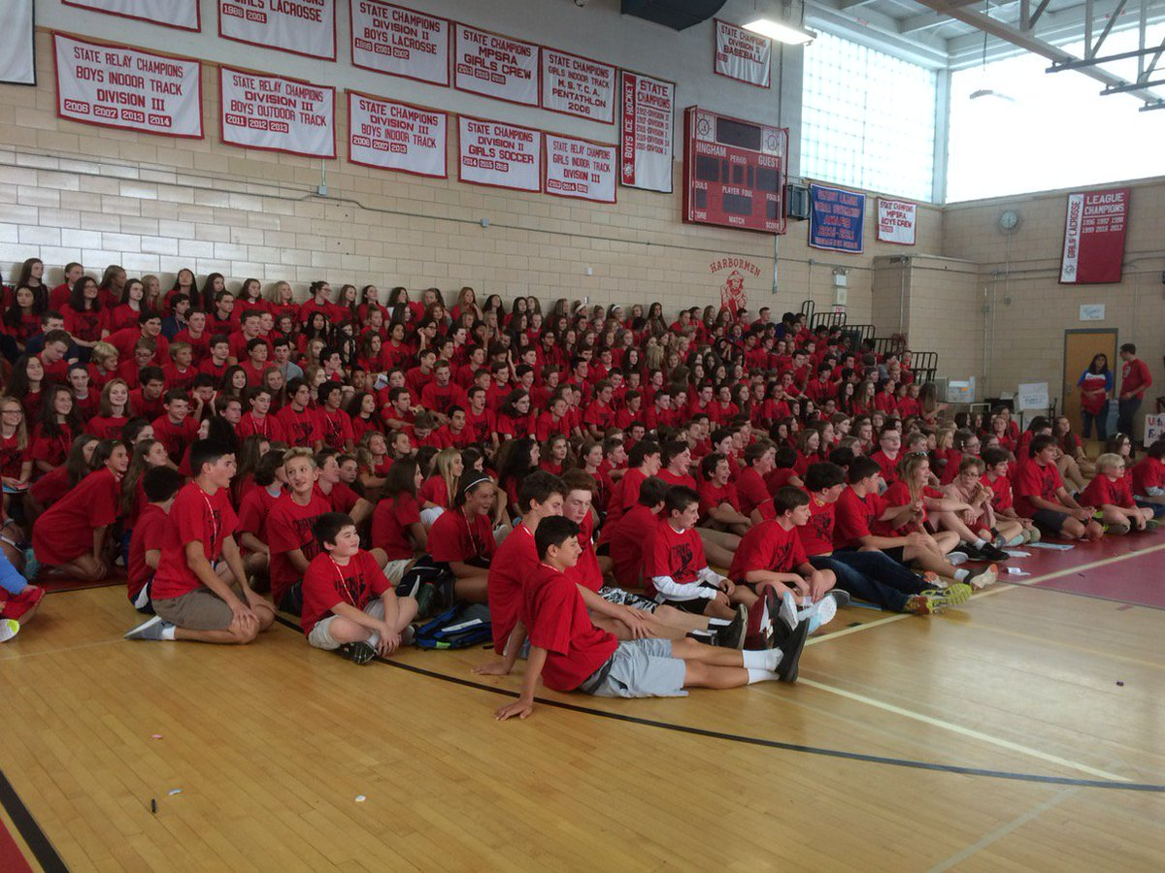
IT WON’T BE LONG!

Slide 33
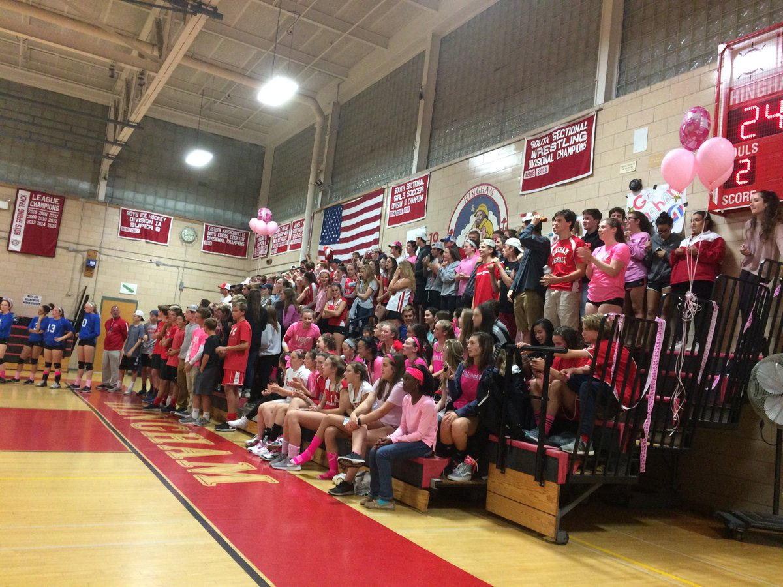
COME BACK SOON!

Slide 34
MAYBE FOR…
THESPIAN NIGHT - MAY 14 @ 7 PM
BAND & ORCHESTRA CONCERT – 5/15 @ 7 PM
GLOBAL SYMPOSIUM – 5/16 @ 6 PM
JUNIOR BOOK AWARDS – 5/22 @ 7 PM
SENIOR ATHLETIC AWARDS – 5/23 @ 7 PM
SINGER-SONGWRITER SHOWCASE – 6/4 @ 7 PM
JAZZ NIGHT – 6/13 @ 7 PM

Slide 35
OTHER IMPORTANT DATES
SPORTS SIGN-UPS - 6/14 @ 2:45 PM (HHS)
COUNSELORS AVAILABLE – 8/22
FOOTBALL BEGINS – 8/17
OTHER FALL SPORTS BEGIN – 8/23
FALL SPORTS PRE-SEASON WORKSHOP – 8/27 @ 7 PM
PICTURE DAY – 8/27
ORIENTATION – 8/30
CLASSES BEGIN – 9/4
HOMECOMING – 10/20

Slide 36
QUESTIONS?

