Slide 1
HINGHAM PUBLIC SCHOOLS
BUDGET OVERVIEW FOR FY 16
Operating Budget Proposal
from the Administration
to the School Committee
DECEMBER 2014

Slide 2
BUDGET PROCESS for FY 2016
School Committee meets in a planning session and then develops and adopts Guiding Principles, Assumptions, and budget calendar
Requests from departments go to building principals
Requests from principals, technology manager, buildings and grounds supervisor, and student services director come to central office
Superintendent and assistant superintendent meet with building principals and directors to discuss needs and review requests
Business director meets with technology, students services, and buildings and grounds supervisor to review requests
Central office administrators establish district priorities and develop administration-proposed budgets
Proposed operating budget is presented to School Committee, initially through budget message and PowerPoint
Notes:
PROCESS STARTS IN SEPTEMBER BEGINNING WITH Requests “FROM THE FIELD”
SEPTEMBER –EARLY JANUARY IS ADMIN PROCESS,
SC PRIORITIZING AND ADOPTION BEGINS IN JANUARY AND CULMINATES WITH TOWN MEETING
HOPEFULLY WITH CONSENSUS FROM SELECTMEN AND ADCOM

Slide 3
FY 16 BUDGET CHALLENGES
Special Education size and number of tuitions and added para hours vs lower CB reimbursement
Facilities Maintenance added responsibil. for staff, need for planning and oversight, project backlog
Expiring Bus Lease cost for bid spec. new buses, cost of additional bus and driver, new EPA req.
Regular Education Staffing new FTEs, FY 15 LOAs (9), anticipated retirements (6), contractual increases
Collective Bargaining Process not all units yet settled for FY 15, need to continue to carry allowance
Full-Day K for All Initiative unknowns that challenge planning and budget and funding plan develop. (enrollment, parent income levels, grant and “foundation” information)

Slide 4
Total K-12 In-District Enrollment
District has grown by 600 students in grades K-12 over past 10 years.
2014-2015 not including Integrated PK (70+ students),vocational students (4), or out-of-district special education students for a current total of 4346 students.
All numbers as of October 1 of each year.

Slide 5
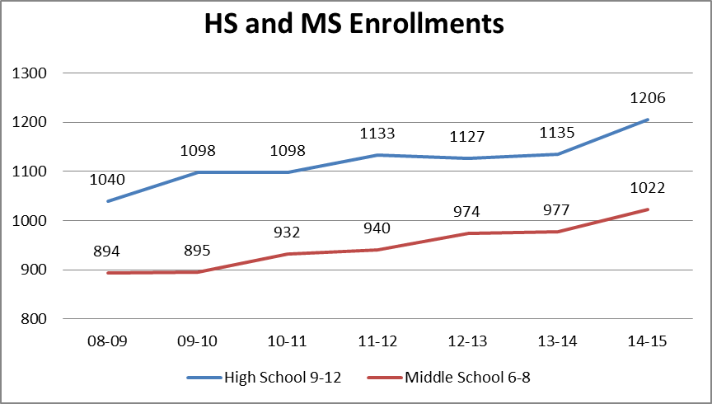

Slide 6
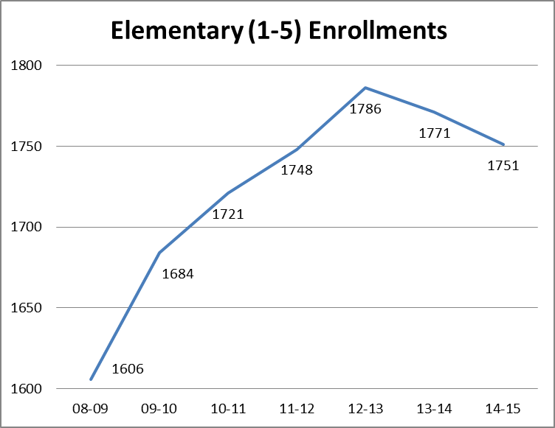

Slide 7
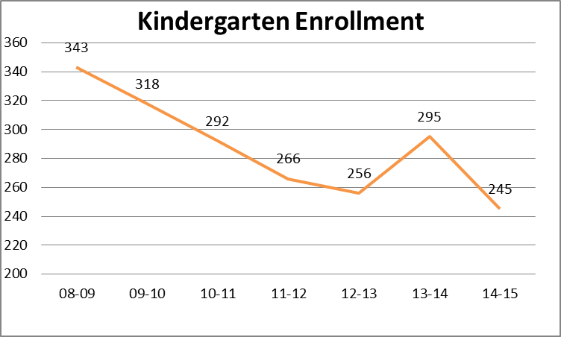

Slide 8
Grade 1 Enrollments, 2007-08 to 2014-15
(prior year k (pink) as a portion of total grade 1 enrollment (pink + green))
What about next year?
What does prior history of the size of the K to 1 “bump” suggest?

Slide 9
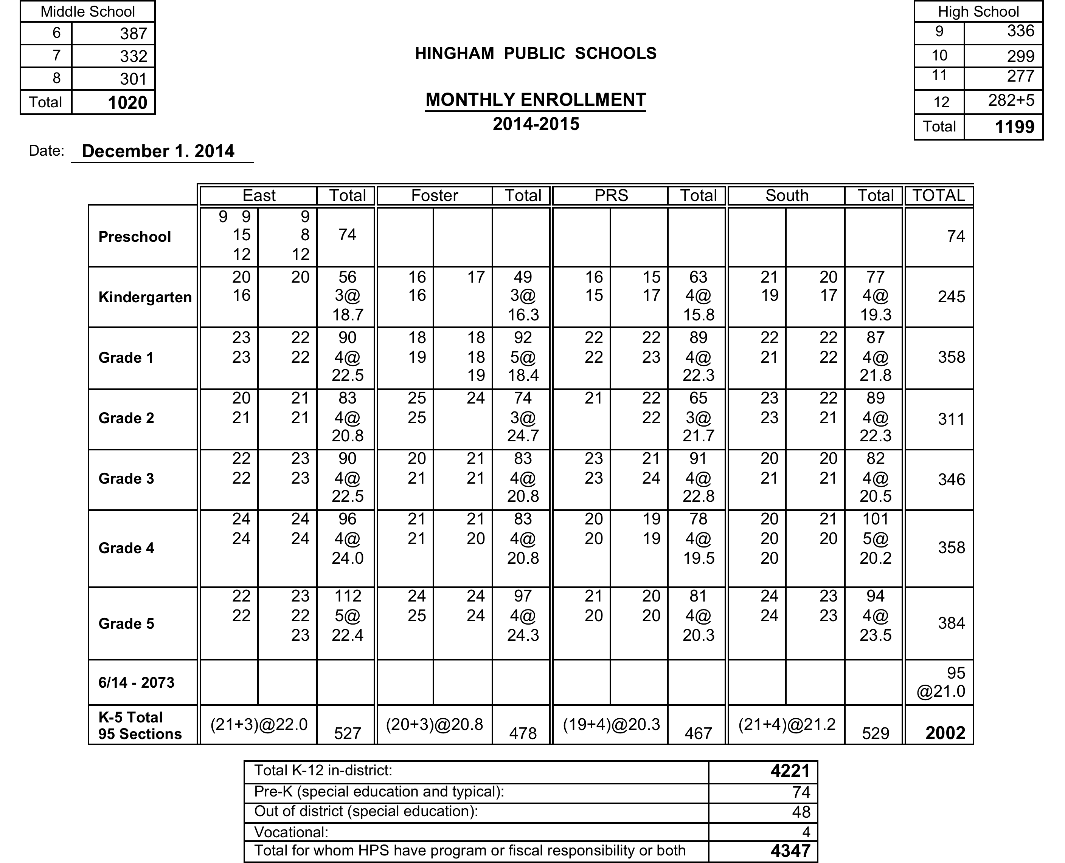

Slide 10
K – 12 Projections for September 2015 (based on moving along December 2014 actuals)
Grades K – 5
2002 - 384 (to gr. 6) + 300 (new K) + 53 (grade K to 1 growth) = 1971
Down 31, plus net other in/out migration
Grades 6-8
1020 - 301 (to HS) + 384 (from grade 5) – 15 (to p.s.) = 1088
Up 68, plus net other in/out migration
Grades 9-12
1199 + 301 (from grade 8) – 282 (graduates) – 15 (to p.s.) = 1203
Up 4, plus other net in/out migration
Projections assume only private school out-migration and only K and K-1 new growth; so they are conservative based upon past experience of at least some other net increases. K number assumes full day for all.
4262
Projected
K -12
Notes:
OUR INTERNAL PROJECTS FOR EACH BUDGET YEAR FOLLOW A SIMPLE STRATEGY.
PROJECT K NUMBER,
PROJECT INCREASE TO GRADE 1,
AND MOVE EVERYONE ELSE ALONG (all real kids).
ASSUME, BUT DO NOT QUANTIFY IN AND OUT MIGRATION
LAST 3 YEARS, GRADE K TO 1 HAS AVERAGED MORE THAN 40

Slide 11
FY 2016 – WORKING DRAFT PROPOSALS
The slides below list categories of proposals recommended by the administration; related costs have been included in the preliminary budget proposal figures.
enrollment related requests
unique needs and challenges
facilities/operational needs
other programmatic or service support needs
Base budget additions are noted in blue. The pink shaded slides include requests that are not recommended to be funded at this time.

Slide 12
Enrollment related requests - These requests reflect additional secondary students anticipated for September 2015 and the underfunding of prior year elementary specialist requests (as enrollments have grown over time).
3.65 HS and 2.8 MS secondary core classroom FTEs - to move existing class groups along (especially for grades 6 to 7 and 9 to 10)
1.4 elementary specialist FTEs (.5 music, .4 Spanish, .5 PE) – to move toward building based specialists in all 6 specialist areas to accommodate the growing number of sections and facilitate the complexities of scheduling shared specialists
.167 increase in literacy coordinator FTEs (.233 to .4) – to accommodate added elementary sections, including focus on literacy standards and interventions, and to begin restoration of literacy oversight FTEs lost with the opening of East School This increase is in the base budget.
Additional large bus (part of lease) and driver (HPS employee) – to accommodate increase in middle school enrollment where ridership is high and requires all 20 large buses

Slide 13
Services that are necessary to meet unique student needs
and challenges
Increased health aide hours (1.5/day MS, .5/day HS) – to provide full day coverage (in addition to the school nurse) to support student health needs and address the growing complexity and increasing number of medical issues. Each of the current health aides is an RN. This is the second part of a two-year plan and is in the base budget.
Math tutor or paraeducator hours for each elementary school – to increase the attention to mathematics interventions, especially for underperforming students at grades 3-5 in an RTI kind of model
Increased paraeducator hours for PRS literacy – PRS does not get Title I support for RTI This increase is in the base budget.

Slide 14
Care of grounds and facilities, operational needs – These recommended additions to the budget address both expanded and unmet needs, increased grounds care and complexity of the new middle school, restoration of a district-wide maintenance worker, and a growing backlog of maintenance and general upkeep issues.
1.0 new role, Manager of Facilities and Procurement – to provide engineering and supervisory expertise to manage needs assessment and planning, and oversight functions for major projects
1.0 maintenance worker – second year request for restoring this role to increase maintenance capability with special attention to care of elementary and middle school fields and to resolve playground issues and enhance safety

Slide 15
Care of grounds and facilities, operational needs – (continued)
Increased overtime hours for custodial staff - to address growing backlog of maintenance projects in a cost effective manner through the use of existing employees
Increased funding for mowing and grounds upkeep and semiannual contractual maintenance for HS and MS fields and grounds – to keep up with added areas that require attention, including islands, plantings, etc. This increase is in the base budget.
Ten sets of snow tires – to increase winter weather safety for vans that transport special education students

Slide 16
Other proposals to address programmatic and/or support service needs
Addition of 2.5 hrs/wk for language lab tech specialist – the second consecutive increase in hours (1.5 hrs/wk in FY 15) to accommodate more sections of foreign language and to allow for greater supervision and training for the new MS lab
Student clerical assistant hours (350) – to provide for summer and vacation coverage, especially at Central Office
Student technology assistant hours (370) – to provide technology support for faculty

Slide 17
Other proposals to address programmatic
and support service needs – continued
X2 programming services – to develop new standards-based elementary report cards
Web-based text materials for a linear algebra pilot program – to be used (with iPad cart in Capital request) for students who struggle with traditional instructional strategies
Advisor for the Green Team – to encourage additional student recycling and other green efforts and support a multi-year role that never has been funded

Slide 18
Additions to the base budget that reflect contractual agreements, external mandates or items that were previously unbudgeted or under budgeted
Additional dollars for contractual lane changes – to meet the level of current requests
Increased cost of new bus lease (for existing number of buses) – projected at 18-20% for new buses in bid specs
Baseline Edge software – purchased in spring 2014 for 2014-2015 use, annual renewal
Virtual High School – pilot program in 2014-2015, more time is needed to evaluate
Enrollment related supplies/materials (science, music, grade 6 exploratory) – previously underfunded

Slide 19
Additions to the base budget - continued
Clerical unit upgrades, included added hours for business and athletic offices – required to respond to the demands of an increased workload, as per salary and guidelines discussions
Three additional days for HS nurse – to meet fall pre-season athletics needs, in place but not reflected in budget
New phone lines for fire alarms, alarm monitoring – reflects HFD change; line and monitoring charges are recurring costs
Security/panic alarm – additional safety/security precaution
Diesel exhaust system fuel additive – new EPA requirement for diesel fuel for any new buses
Lease of three copiers – copiers are for East to replace those purchased as part of building project

Slide 20
Requests from administrators NOT INCLUDED in this budget proposal and NOT RECOMMENDED at this time – These requests are all worthwhile but, in the opinion of the central office administration, but do not rise to the same level of priority for FY 16 as do other requests; so each is recommended to be deferred at this time.
1.0 Transition Room paraeducator – The Transition Room is an unqualified success and more resources would surely benefit students, but other priorities also exist for the coming year.
Expansion of the Freshman Advisory Program to grades 10-12 – This request is a high priority of the HS principal; deferral is recommended only because of needs in other areas.
1.5 custodians (.5 @ at PRS, MS, South) – This is an area that received significant attention in the FY 15 budget.

Slide 21
Requests from administrators that were NOT INCLUDED in this budget proposal – continued
1.0 MS guidance counselor – This request reflects the increased MS enrollment and the per student load for the existing three counselors. In FY 15, additional summer hours were added and the adjustment counselor was restored to full time.
HS club advisors (biking, GCP 2nd adv.) - Several new clubs were added over the past couple of years; hence the recommendation to defer these two to fund other high priority requests for FY 16.
Robotics supplies – Corporate sponsorship is still being sought; a repeat of grant funding will provide for a second year of competition; the advisor role is now funded.
1.0 Communications/Webmaster, new role – Funding priority has been given to requests for new roles that have a more direct student or facilities impact.

Slide 22
Full-Day K for ALL Proposed Budget
Classroom Teachers | 5.0 | New FTEs | $306,990
 | 1.5 | (three existing .5 staff to 1.0 FTE status) | 97,834
 |  |  | $404,824
Specialist Teachers | 2.2 | (.2 art, .5 music, .5 PE, 1.0 Spanish) | $128,794
Special Ed. Teachers | 2.0 | (.5 per building) | $122,796
Para Hours | To bring all K classes full-time paraeducators |  | $187,530
TOTAL NEW COSTS |  |  | $843,944
Notes:
Assumes 300 students, 15 sections for 2015-2016
Excludes equipment, materials, furnishings, etc., offset by $86,779K state grant
Proposed cost for 14 sections is ± $80K less
± $71K possible savings for midday transportation
± $67K loss of “typical student” tuition to revolving account

Slide 23
“Sample” of a Full-Day K for All Funding Plan ( a “work in progress”)
Parent Paid Tuitions*
Other Funding Sources**
Total Revenue ± $650 K
Tuition scale would need to meet state criteria and be approved by DESE. Revenue figure is an estimate based on assumptions about total enrollment and family incomes.
DESE K “Quality Grant” Fund #701 (competitive grant) $80K to $120 K
Town contribution to support program costs for tuition free students $200 K
Additional Ch. 70 “Foundation Budget
dollars, after first year TBD
*Revenue from tuitions, on a sliding income scale ($0 to $3,500 annual cost to family per student). In this model, ¼ of students would pay no fee.
**
Grant status would not be known until Fall 2015 (dollars, if any, to come to HPS during 2015-2016).
Amount to be requested for FY 16
Foundation budget increase is possible only for “tuition-free” students who move to full day K; (any such dollars would come to Town as part of FY 17 MA budget allocation and thereafter).

