Slide 1
HINGHAM PUBLIC SCHOOLS
FY 2016
Proposed Operating Budget
February 5, 2015
Joint Meeting

Slide 2
FY 16 BUDGET CHALLENGES
Special Education size and number of tuitions and added para hours vs lower CB reimbursement
Facilities Maintenance added responsibil. for staff, need for planning and oversight, project backlog
Expiring Bus Lease cost for bid spec. new buses, cost of additional bus and driver, new EPA req.
Regular Education Staffing new FTEs, FY 15 LOAs (9), anticipated retirements (6), contractual increases
Collective Bargaining Process not all units yet settled for FY 15, need to continue to carry allowance
Full-Day K for All Initiative unknowns that challenge planning and budget and funding plan development (enrollment, parent income levels, grant and “foundation” information)

Slide 3
WHAT IS A “NEEDS - BASED” BUDGET
A proposal from the Admin. to the SC that reflects areas of concern, mission alignment, and priorities for improvement, as identified by Principals, Directors, and Central Office
One that includes actual costs where they are known or projections based upon current information about costs and available funding
One where “needs” are broadly defined to encompass responses to: enrollment increases or a changing demographic profile or a backlog of program, service or facilities deficiencies (the result of prior cuts or underfunding or new needs) or federal and state mandates, SC priorities, and community expectations

Slide 5
Row Labels | Base | High | Grand Total
1200 | $21,295 | $4,200 | $25,495
Increase 10 hours in business office support (payroll and accounting) | $14,095 |  | $14,095
Upgrades for Secretaries and Assistants | $7,200 |  | $7,200
Student Office Assistants Winter and Summer 350 hours 12.00 |  | $4,200 | $4,200
2300 | $79,306 | $545,442 | $624,748
Add Tutors, Para for Math at Elementary Schools |  | $79,025 | $79,025
High School FTE 3.625 at Various Rates (reduced to 2.625) |  | $207,921 | $207,921
MS FTEs 2.8 at various rates |  | $180,691 | $180,691
PRS tutor Hours | $5,862 |  | $5,862
Virtual High School | $12,000 |  | $12,000
Supplies FCS - Exploratory Offering | $3,000 |  | $3,000
Supplies Industrial Arts - Exploratory Offering | $2,000 |  | $2,000
Science Consumables in Lieu of Texts | $4,000 |  | $4,000
Increase .167 in Literacy Coord..role (restoration) | $15,947 |  | $15,947
Spanish goes to 1.0 from .6 -Enrollment Restoration |  | $23,578 | $23,578
PE Elementary .5 at B4 - Enrollment/Restoration |  | $25,983 | $25,983
Elementary Music .5 -Enrollment/Restoration B/5 |  | $28,245 | $28,245
Increase in Degree changes to $110,000 due to contract change | $25,000 |  | $25,000
Baseline Edge - Evaluation Tracking Software | $11,498 |  | $11,498
2400 |  | $3,000 | $3,000
Increase in web- based texts $3000 for Linear Algebra |  | $3,000 | $3,000
2410 | $10,800 |  | $10,800
Copiers East - Lease (3) New Machines, Move older ones to other schools | $10,800 |  | $10,800
2450 |  | $13,055 | $13,055
Increase Language Lab tech by.5hrs. Daily( 2.5/ week) to cover half day at MS |  | $2,055 | $2,055
Summer and School Year Student Help - Technology 370 Hours at 13.50+- |  | $5,000 | $5,000
Design Programming Consulting Services - X2 Report Card Design |  | $6,000 | $6,000
3200 | $8,127 |  | $8,127
3 Extra Days for HS Nurse - Sports | $1,219 |  | $1,219
Increase health Aide Hours per day by 1.5 MS and .5 HS at highest pay rate | $6,908 |  | $6,908

Slide 6
Row Labels | Base | High | Grand Total
3300 | $87,794 | $52,798 | $140,592
New Bus Driver |  | $26,867 | $26,867
New Bus EPA requirement - DEF - Diesel Exhaust Fluid @ 5% of Gallons | $8,684 |  | $8,684
New Bus Lease ( Assume “high teen” - 18% increase) | $79,110 |  | $79,110
New Bus MS growth in enrollment 92% ride |  | $25,931 | $25,931
3510 | $1,681 |  | $1,681
Increase days for clerical support for athletics | $1,681 |  | $1,681
3520 |  | $1,269 | $1,269
New-Advisor stipend for HS Green Team |  | $1,269 | $1,269
3600 | $2,000 |  | $2,000
Security - Lynx Panic Alarm System | $2,000 |  | $2,000
4110 |  | $5,000 | $5,000
Custodian Overtime ( Overtime for Maintenance Projects) |  | $5,000 | $5,000
4130 | $9,600 |  | $9,600
Phone Lines for Alarm Monitoring – see below | $9,600 |  | $9,600
4210 | $25,900 |  | $25,900
18 mows at 3 men for 3 hours (ex, new islands) | $8,100 |  | $8,100
Field Maintenance Contract - 2 major cleanings | $17,800 |  | $17,800
4220 | $8,000 | $137,857 | $145,857
Add. of 1.0 Maintenance (cover elem. and MS grounds and gen. maintenance) |  | $43,857 | $43,857
Expanded Recycling |  | $4,000 | $4,000
Manager of Facilities and Procurement |  | $90,000 | $90,000
Alarm monitoring in lieu of Fire Department (Annual Rate per Building) | $8,000 |  | $8,000
4230 | $2,400 |  | $2,400
Music Repair and Tuning Increase | $2,400 |  | $2,400
3300B |  | $7,000 | $7,000
Snow Tires - Set of 4 for ten vans |  | $7,000 | $7,000
Grand Total | $256,904 | $769,621 | $1,026,525

Slide 7
Hingham Public Schools Proposed FY 2015 - 2016 Budget Adjusted as of January 29, 2015
Account | Item | Old Rate | New Rate | Change | Net | Date Noted
R2300 | Return form LOA | $0 | $70,883 | $70,883 |  | 1/21/2015
R2300 | Remove Retirement Vacancy - LOA fills it | $56,490 | $0 | ($56,490) | $14,393 | 1/21/2015
R2500 | New LOA | $92,331 | $0 | ($92,331) |  | 1/21/2015
R2500 | Replace LOA with LTS M/5 | $0 | $61,398 | $61,398 | ($30,933) | 1/21/2015
R2300 | Remove Baseline Edge | $11,498 | $0 | ($11,498) |  | 1/21/2015
S2300B | Reduce PRS Para Hours 50 Per Week | $358,427 | $324,835 | ($33,592) |  | 1/21/2015
R2700 | Increase Guidance Travel | $1,500 | $2,500 | $1,000 |  | 1/21/2015
R3510 | Increase Athletic Revolving to cover need for additional support | -$294,000 | -$295,681 | ($1,681) |  | 1/21/2015
R3300 | Remove New Bus Driver | $25,753 | $0 | ($25,753) |  | 1/22/2015
R3300 | Reduced Lease and Remove New Bus | $83,670 |  | ($83,670) |  | 1/22/2015
R3300 | Remove need to DEF Additive | $8,683 |  | ($8,683) |  | 1/22/2015
R2300 | Remove 1.0 New HS | $61,398 |  | ($61,398) |  | 1/29/2015
R3300 | 1/2 Kindergarten Mid Day buses | $35,000 |  | ($35,000) |  | 1/29/2015
S9100B | Sped Tuition | $36,226 |  | ($36,226) |  | 1/29/2015
R2300 | Anticipated Retirement | $97,141 | $56,490 | ($40,651) |  | 1/29/2015
R4220 | Offset Facilities Procurement Position Est. |  | -$30,000 | ($30,000) |  | 1/29/2015
R5100 | Retirement/Sick Bank Payout | $0 | $2,000 | $2,000 |  | 1/29/2015
 | Increase to Base /(Decrease to Base) - Adj. |  |  | ($381,692)
 | Adjustments as of 1/21/2015 |  |  | $62,311
 | New adjustments as of 1/29/2015 |  |  | $319,381
 | Budget Base FY 15 | Orginal FY 16 | Orig Change | Adjustments | Adj. Change | Percent
 | $43,490,722 | $46,572,683 | $3,081,961 | ($381,692) | $2,700,269 | 6.21%

Slide 8
HINGHAM PUBLIC SCHOOLS
Proposed FY 2015 - 2016 BUDGET as Adjusted on January 29, 2015
Regular Education, Special Education, Vo-Tech Budget Breakdown
 |  |  |  |  | Proposed
 |  | Budget | Budget | Budget | Budget | Increase | %
ACCOUNT | ACCOUNT TITLE | 2012-2013 | 2013-2014 | 2014-2015 | 2015-2016 | (Decrease) | Change
1100 | School Committee | $45,850 | $46,850 | $46,850 | $51,850 | $5,000
1200 | Administration | $846,853 | $900,081 | $929,630 | $967,272 | $37,641
2200 | Principals | $1,760,477 | $2,019,205 | $2,038,765 | $2,086,062 | $47,297
2300 | Teaching | $18,645,917 | $19,132,387 | $20,173,486 | $21,584,369 | $1,410,884
2350 | Professional Development | $185,100 | $187,000 | $212,590 | $223,340 | $10,750
2400 | Textbooks | $237,137 | $264,066 | $286,586 | $353,533 | $66,947
2410 | Instructional Equipment | $11,500 | $22,700 | $30,661 | $37,399 | $6,738
2450 | Instructional Technology | $585,947 | $710,366 | $754,310 | $799,721 | $45,412
2500 | Library | $537,159 | $600,901 | $634,320 | $626,627 | -$7,693
2700 | Counseling | $876,234 | $951,807 | $1,008,539 | $1,026,918 | $18,379
2800 | Psychological Services | $329,464 | $339,448 | $489,640 | $507,960 | $18,320
3200 | Health Services | $477,485 | $487,893 | $510,258 | $554,608 | $44,349
3300 | Transportation | $1,236,613 | $1,298,185 | $1,293,024 | $1,320,546 | $27,522
3510 | Athletics | $595,919 | $596,212 | $605,994 | $631,094 | $25,101
3520 | Other Student Activity | $94,706 | $103,041 | $119,767 | $121,822 | $2,055
4110 | Custodial | $1,329,369 | $1,442,428 | $1,545,001 | $1,623,165 | $78,164
4120 | Heating of Buildings | $458,369 | $465,388 | $551,022 | $570,469 | $19,447
4130 | Utilities | $732,145 | $724,333 | $863,924 | $858,641 | -$5,283
4210 | Maintenance of Grounds | $13,478 | $27,288 | $69,788 | $95,882 | $26,094
4220 | Plant Maintenance | $718,640 | $757,748 | $812,286 | $943,639 | $131,354
4230 | Repairs of Equipment | $107,370 | $106,053 | $106,550 | $110,491 | $3,941
5100 | Employee Retirement | $75,792 | $63,516 | $23,755 | $75,940 | $52,185
7000 | Non-Instructional Equipment | 0 | 0 | 0 | 0 | $0
 | Allowance for increases | $21,671 | $53,557 | $273,887 | $62,949 | -$210,938
 | Total Regular Education | $29,923,194 | $31,300,452 | $33,380,634 | $35,234,300 | $1,853,666 | 5.55%

Slide 9
HINGHAM PUBLIC SCHOOLS
Proposed FY 2015 - 2016 BUDGET as Adjusted on January 29, 2015
Regular Education, Special Education, Vo-Tech Budget Breakdown
 |  |  |  |  | Proposed
 |  | Budget | Budget | Budget | Budget | Increase | %
ACCOUNT | ACCOUNT TITLE | 2012-2013 | 2013-2014 | 2014-2015 | 2015-2016 | (Decrease) | Change
2100B | Sped Supervision | $238,244 | $241,690 | $252,862 | $246,102 | -$6,760
2300B | Sped Instruction | $5,457,819 | $5,667,476 | $5,949,319 | $6,147,439 | $198,120
2350B | Sped Prof. Development | $10,700 | $9,900 | $9,900 | $9,900 | $0
2400B | Sped Textbooks | $900 | $900 | $900 | $900 | $0
2700B | Sped Counseling | $388,316 | $405,603 | $494,426 | $515,662 | $21,237
2800B | Sped Psychological Services | $231,753 | $245,277 | $248,714 | $261,237 | $12,523
3300B | Sped Transportation | $627,287 | $573,011 | $562,563 | $591,468 | $28,906
9100B | Sped Prog w/other Districts | $3,543,599 | $3,255,628 | $2,496,457 | $3,112,802 | $616,345
 | Total Special Education | $10,498,618 | $10,399,485 | $10,015,139 | $10,885,509 | $870,370 | 8.69%
3300E | Vocational Transportation | $10,400 | $10,400 | $10,400 | $10,400 | $0
9100E | Vocational Tuition | $135,108 | $127,892 | $84,548 | $60,782 | -$23,766
 | Total Votech | $145,508 | $138,292 | $94,948 | $71,182 | -$23,766 | (25.03%)
 | Total Proposed Budget | $40,567,321 | $41,838,228 | $43,490,722 | $46,190,991 | $2,700,269 | 6.21%

Slide 10
HINGHAM PUBLIC SCHOOLS Grant and Revenue Account Offsets
 |  |  |  | Proposed
 | Budget | Budget | Budget | Budget
 | 2012-2013 | 2013-2014 | 2014-2015 | 2015-2016
Gross Special Ed Spending | 12,281,751 | 12,278,358 | 12,266,576 | 13,066,511
Grants
IDEA | -797,518 | -825,265 | -853,263 | -854,772
ECC | -13,490 | -13,490 | -13,490 | -13,490
CB | -767,625 | -777,118 | -1,160,184 | -942,740
Tuition Revolving | -200,000 | -220,000 | -220,000 | -370,000
Other Revolving SSEC/Grant | -4,500 | -43,000 | -4,500 | 0
Total Offsets | -1,783,133 | -1,878,873 | -2,251,437 | -2,181,002
Net Spending - Special Ed | 10,498,618 | 10,399,485 | 10,015,139 | 10,885,509
Gross Regular Ed Spending | 30,367,784 | 31,581,136 | 33,803,356 | 35,657,074
Revenue Offsets
Athletics | -224,000 | -260,000 | -294,000 | -295,681
Middle School Activity | -53,789 | -64,949 | -74,116 | -76,139
Field Revolving Account | -66,500 | -46,500 | -10,000 | -10,000
Building Revolving Account | -23,850 | -20,819 | -7,500 | -8,850
Kids In Action | -10,000 | 0 | 0 | 0
Drivers Ed | -10,000 | -10,000 | -5,000 | -5,000
Continuing Ed | -10,000 | -10,000 | -5,000 | 0
Other (Drama, Student Parking) | -13,000 | -13,000 | -9,000 | -9,000
Cable Grant | -33,451 | -36,208 | -18,104 | -18,104
Other Offsets
Total Offsets | -444,590 | -461,476 | -422,720 | -422,774
Net Spending Regular Ed | 29,923,194 | 31,119,660 | 33,380,636 | 35,234,300
Total Offsets via Grants/Fees and Receipts | -2,227,723 | -2,340,349 | -2,674,157 | -2,603,776

Slide 13
FY 16 PROPOSED ADDITIONAL FTEs (as of 2-5-15)
New FTEs:
Elementary spec. 1.4 (.5 PE. .5 music, .4 Span.)
MS Core Teaching 2.8
(1.6 math/sci, .4 FL, .4 SS, .4 ELA)
HS Core Teaching 2.625
(.625 ELA, 1.0 sci, 1.0 math)
Facilities Personnel 2.0
(1.0 Mainten., 1.0 Facil. Manager)
TOTAL 8.825
Note: The FDK addition is 10.7 FTEs, of which 3.7 are additions to existing staff. With FD K the grand total of “new” FTEs is 14.6.
FTEs (from 8.825) added to existing staff:
HS Core Teaching .625
MS Core Teaching 1.2
Elem. Specialists .4
TOTAL 2.225
Note: Over the last several years the % of total HPS employees participating in health insurance has ranged from 49% to 56%. This year it is 45% overall, 52% for teachers.

Slide 14
Total K-12 In-District Enrollment
District has grown by 600 students in grades K-12 over past 10 years.
2014-2015 not including Integrated PK (70+ students),vocational students (4), or out-of-district special education students for a current total of 4346 students.
All numbers as of October 1 of each year.

Slide 15
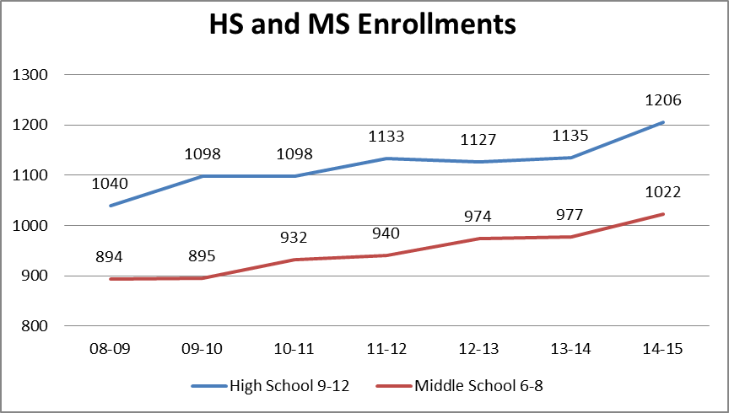

Slide 16
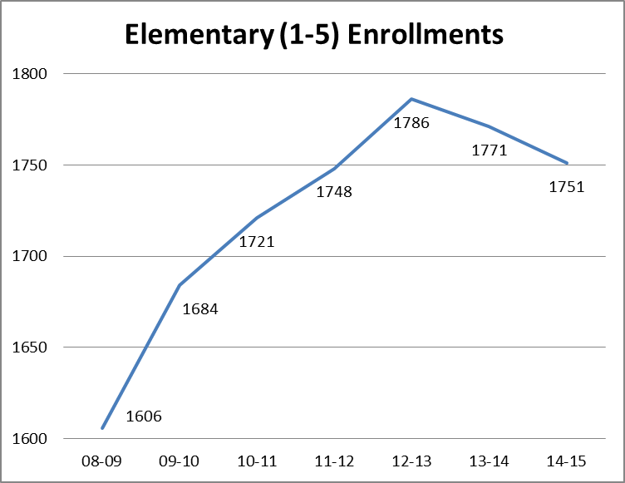

Slide 17
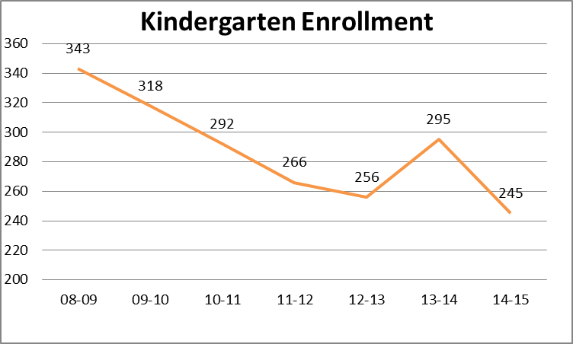

Slide 18
Grade 1 Enrollments, 2007-08 to 2014-15
(prior year K (pink) as a portion of total grade 1 enrollment (pink + green)
What about next year?
What does prior history of the size of the K to 1 “bump” suggest?

Slide 19
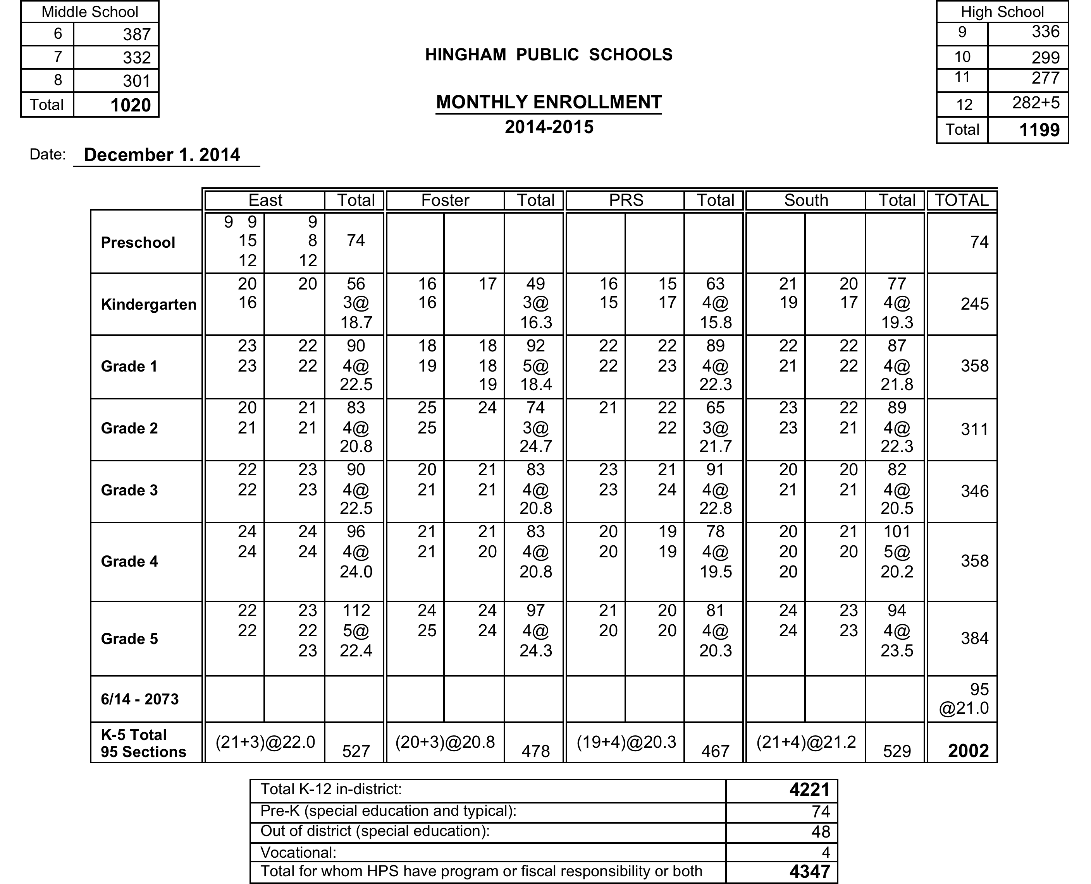

Slide 20
K – 12 Projections for September 2015 (based on moving along December 2014 actuals)
Grades K – 5
2002 - 384 (to gr. 6) + 300 (new K) + 53 (grade K to 1 growth) = 1971
Down 31, plus net other in/out migration
Grades 6-8
1020 - 301 (to HS) + 384 (from grade 5) – 15 (to p.s.) = 1088
Up 68, plus net other in/out migration
Grades 9-12
1199 + 301 (from grade 8) – 282 (graduates) – 15 (to p.s.) = 1203
Up 4, plus other net in/out migration
Projections assume only private school out-migration and only K and K-1 new growth; so they are conservative based upon past experience of at least some other net increases. K number assumes full day for all.
4262
Projected
K -12
Notes:
OUR INTERNAL PROJECTS FOR EACH BUDGET YEAR FOLLOW A SIMPLE STRATEGY.
PROJECT K NUMBER,
PROJECT INCREASE TO GRADE 1,
AND MOVE EVERYONE ELSE ALONG (all real kids).
ASSUME, BUT DO NOT QUANTIFY IN AND OUT MIGRATION
LAST 3 YEARS, GRADE K TO 1 HAS AVERAGED MORE THAN 40

Slide 22
SPECIAL DUCATIN BUDGET AS % OF TOTAL SCHOOL OPERATING BUDGET
FY ’98 TO FY ’13
Fiscal Year % of Total Operating Circuit Breaker
FY 98 15.7%
FY 99 16.8%
FY 00 17.8%
FY 01 17.1%
FY 02 17.7%
FY 03 19.0%
FY 04 20.1% 125,804
FY 05 20.9% 150,000
FY 06 20.6% 589,384
FY 07 20.6% 556,912
FY 08 22.5% 641,777
FY 09 23.3% 607,366
FY 10 23.3% 845,081
FY 11 21.5% 513,039
FY 12 24.6% 438,670
FY 13 (proposed) 25.1% 767,625
(Budget figures are net of grants and offsets, including Circuit Breaker)

Slide 25
SPECIAL EDUCATION ENROLLMENT January 2015 “Snapshot”
By Level (In + Out of District)
By Building
Pre-K 40 + 1
Elem. K-5 175 + 9
MS 6-8 171 + 7
HS 9-12+ 152 + 29
TOTALS 538 + 46 #
584
# Does not include one SEIS student, whose tuition is deducted directly from Hingham’s Chapter 70 allocation.
EAST 46 K-5 + 40 PK
FOSTER 35 K-5
PRS 57 K-5
SOUTH 37 K-5
MS 171 6-8
HS 152* 9-12+
TOTAL 538
* Includes 5 students in grade 12 +

Slide 26
FY 2016 - Special Education Staffing
FTEs under 2300 B
FTEs in other functions
3.0 Pre-K (E) 3.0 Ext K. (E,S)
4.O Foster (K-5) 4.0 PRS (K-5)
4.0 East (K-5) 4.0 South (K-5)
7.0 MS (6-8) 7.0 HS (9-12+)
5.0 Speech/Lang.** (see CS)
2.0 Occup. Therapy
5.8 Reading
1.0 ABA (new in 2014 – 2015)
Support hours
Para-educators, tutors, building clerical (hourly)
2100B Director 1.0
2100B C.O. Clerical 2.0
2700B Elem. Psych./Chairs (4.0)
2700B E. Childhood Coord. (.7)
2700B OOD Coordinator
2800B Sec. Psychologists (3.0)
____________
Contracted Services (CS)
English Support Tutor(1 part-time), Phys. Ther.(1 part-time), **Sp./Lang. (2 part-time)

Slide 27
Out of District *Tuitions (2015-2016, projected for 56 students)
Type of School
*Tuition Range
Private Day Schools (16)
Private Residential Schools (11)
SEIS (Public) Residential (1)
Other Public Schools (2)
South Shore Educ. Collab. (20)
Other Local Collaboratives (6)
*Tuitions include known increases and projections for OSD requested increases. Some tuitions are for year-round services; some reflect a shared funding
$ 26,090 to $ 114,500
$ 45,300 to $ 268,735
Deducted from Chapter 70
$ 36,266 to $ 53605
$ 45,855 to $ 65,882
$ 34,530 to $ 67,000
SEIS - Special Education in Institutional Settings (add’l services only)
OSD – Operational Services Division

Slide 28
Hingham Public Schools FY 2015 – 2016 Proposed Budget

Slide 29
Administration, Facilities, Health and Transportation Trend FY 16 Preliminary Budget

Slide 30
Hingham Public Schools FY 16 Preliminary Budget

Slide 31
Energy Budget Natural Gas
New MS converts to natural gas In FY 15

Slide 32
Energy Budget Oil
New MS - Gas Heat FY 15

Slide 33
Electric Budget
New MS built to current day code

Slide 34
Proposed Organizational Structure
New Position
Facilities & Procurement Mgr.
Director of Athletics
Building and Grounds Maintenance Supervisor
HS Building and Grounds Supervisor
Custodian Supervisor – Elem and MS
.7
Barry
Mike
Custodians
(8.25)
Custodians
(18)
Bill
Peter
New Grounds for Elementary and MS

Slide 35
Care of grounds and facilities, operational needs – These recommended additions to the budget address both expanded and unmet needs, increased grounds care and complexity of the new middle school, restoration of a district-wide maintenance worker, and a growing backlog of maintenance and general upkeep issues.
1.0 new role, Manager of Facilities and Procurement – to provide engineering and supervisory expertise to manage needs assessment and planning, and oversight functions for major projects
1.0 maintenance worker – second year request for restoring this role to increase maintenance capability with special attention to care of elementary and middle school fields and to resolve playground issues and enhance safety

Slide 36
Services that are necessary to meet unique student needs
and challenges
Increased health aide hours (1.5/day MS, .5/day HS) – to provide full day coverage (in addition to the school nurse) to support student health needs and address the growing complexity and increasing number of medical issues. Each of the current health aides is an RN. This is the second part of a two-year plan and is in the base budget.
Math tutor or paraeducator hours for each elementary school – to increase the attention to mathematics interventions, especially for underperforming students at grades 3-5 in an RTI kind of model
Increased paraeducator hours for PRS literacy – PRS does not get Title I support for RTI This increase is in the base budget.

Slide 37
Full-Day K for ALL Proposed Budget
Classroom Teachers | 5.0 | New FTEs | $306,990
 | 1.5 | (three existing .5 staff to 1.0 FTE status) | 97,834
 |  |  | $404,824
Specialist Teachers | 2.2 | (.2 art, .5 music, .5 PE, 1.0 Spanish) | $128,794
Special Ed. Teachers | 2.0 | (.5 per building) | $122,796
Para Hours | To bring all K classes full-time paraeducators |  | $187,530
TOTAL NEW COSTS |  |  | $843,944
Notes:
Assumes 300 students, 15 sections for 2015-2016
Excludes equipment, materials, furnishings, etc., offset by $86,779K state grant
Proposed cost for 14 sections is ± $80K less
± $71K possible savings for midday transportation
± $67K loss of “typical student” tuition to revolving account

Slide 38
“Sample” of a Full-Day K for All Funding Plan ( a “work in progress”)
Parent Paid Tuitions*
Other Funding Sources**
Total Revenue ± $650 K
Tuition scale would need to meet state criteria and be approved by DESE. Revenue figure is an estimate based on assumptions about total enrollment and family incomes.
DESE K “Quality Grant” Fund #701 (competitive grant) $80K to $120 K
Town contribution to support program costs $200 K
Additional Ch. 70 “Foundation Budget
dollars, after first year TBD
*Revenue from tuitions, on a sliding income scale ($0 to $3,500 annual cost to family per student). In this model, ¼ of students would pay no fee.
**
Grant status would not be known until Fall 2015 (dollars, if any, to come to HPS during 2015-2016).
Amount to be requested for FY 16
Foundation budget increase is possible only for “tuition-free” students who move to full day K; (any such dollars would come to Town as part of FY 17 MA budget allocation and thereafter).

Slide 39
Revised Administration - Proposed Funding Proposal for FD K
Consider the 15 – 16 school year as a “pilot” year in terms of the funding plan
Fund the total FD K FY 16 budget (as may be adjusted for the actual enrollment) with tuition revenue
Create a tuition scale using $3500 as the maximum tuition
Develop a multi-year plan for absorbing the total program cost into the annual operating budget (ex. over a 3-5 year period), using the pilot year experience as a basis for the transition details and for making interim annual adjustments to the tuition scale

Slide 40
Full Day Kindergarten Impact
Costs for 4.0 special education teachers to move to 2300B
Costs for 3.0 new teachers and 1.5 FTEs for teachers moving from .5 to 1.0 to move to 2300
Costs for 2.2 specialists (.5 music, .5 PE, 1.0 Spanish, .2 art) to move to 2300
Costs for additional para hours (to achieve 1.0 per classroom) to move to 2300
Total cost * ($850 K) to be offset by tuition revenue and reducing the bottom line
* Assumes 300 students and 15 sections, $80K less for 14 sections

Slide 41
Capital Projects (Total Request as of 1/22/15 is $1,297,715)
Notable Items for FY 16
High School hot water boiler
East School erosion control and play field development
High School fitness room expansion –design only
Foster shed painting and FRP Panels
High School cafeteria modifications
Business Office automation project

Slide 42
FY 16 Capital Projects (continued)
Deferred from FY 15 (partial list)
Converting fire call boxes at all locations
Food service equipment to replace aging equipment
Special Education van replacement program
Depot paving (town-wide use, especially for fuel depot access)
Annual technology, maintenance, and instructional equipment lists

Slide 43
Deferred Capital Projects (need attention and a multi-department solution)
Building 179 Renovations/Building 12
Waiting on Town-wide Solution
Increasing Cost to Renovate
Garage Doors, Building Repairs, etc.
Town-wide use of “Bus Garage”
Not included in School Department request

Slide 44
THINKING ABOUT OTHER CHANGES AND POTENTIAL REDUCTIONS OR POSSIBLE REVENUES
(where are the biggest swings possible?)
PERSONNEL CATEGORIES – New full year LOAs, resignations, or retirements
SPECIAL EDUCATION – Tuition decisions by OSD, pending placements, unanticipated placements
STATE FUNDING – CHAPTER 70 Review Commission recommendations, cuts to local aid or CB allocations
OFFSETS and/or REVOLVING ACCOUNTS – New fee/tuition structure revenues, increased RA offsets to Operating Budget
VOCATIONAL EDUCATION – Potential new student(s)

Slide 45
TERMS TO DEFINE DOES IT DEPEND UPON CONTEXT? IS MEANING IN THE EYES OF THE BEHOLDER?
Sustainability
Level Services
Equity

