Slide 1


HINGHAM PUBLIC SCHOOLS
BUDGET HEARING # 1 FOR FY 14
January 10, 2013
Operating Budget Proposal
from the Administration to the School Committee
Functions: 1100, 1200, 2200, 2300, 2350,
2400, 2450, 2500 2700, 2800, 3200, 5100,
3300E, 9100E, Other

Slide 2
ADMINISTRATION’S PROPOSED BUDGET
What’s new for 2014 ??
The proposed budget reflects:
Additional ”user” backup information for decision makers and priority setters
Continued separation of regular and special education budgets during development process
A different starting point for discussion, but an expectation for a similar process of collaborative decision making
The proposed budget is:
NOT the expected end point
  NOT intended to convey a lack of sensitivity or awareness of fiscal realities
NOT a perfect product
  Errors exist and will be corrected.
  Changes will occur over the discussion process and info will be updated.

Slide 4
K-12
HPS ENROLLMENT BY SCHOOLS
(October 1 of each year)
2005 - 2006 THROUGH 2012 - 2013
HS
MS
Elem.

Slide 5
376
356
342
333
319
297

Slide 6
K – 12 Projections for September 2014
(based on moving along December 2012 actuals)
Grades K – 5
2041 -339 (to gr. 6) + 256 (new K) + 60 (grade K to 1 growth) = 2018
Down 23, plus net in/out migration
Grades 6-8
974 - 316 (to HS) + 339 (from grade 5) = 997
Up 23, plus net in/out migration
Grades 9-12
1127 + 316 (from grade 8) – 276 (graduates) = 1167
Up 40, plus net in/out migration
Projections assume no net in/out-migration, so are conservative based upon past practice of at least some net increases.
4182
PROJECTED
K-12 TOTAL
Notes:
OUR INTERNAL PROJECTS FOR EACH BUDGET YEAR FOLLOW A SIMPLE STRATEGY.
PROJECT K NUMBER,
PROJECT INCREASE TO GRADE 1,
AND MOVE EVERYONE ELSE ALONG (all real kids).
ASSUME, BUT DO NOT QUANTIFY IN AND OUT MIGRATION
LAST 3 YEARS, GRADE K TO 1 HAS AVERAGED MORE THAN 40

Slide 7
BUDGET PROCESS for FY 2014
School Committee meets in a planning session and then develops and adopts Guiding Principles, Assumptions, and budget calendar
Requests from departments go to building principals
Requests from principals, technology manager, buildings and grounds supervisor, and student services director come to central office
Superintendent and assistant superintendent meet with building principals and directors to discuss needs and review requests
Business director meets with technology manager, students services director, and buildings and grounds supervisor to review requests
Central office administrators establish district priorities and develop administration- proposed budgets
Proposed operating budget is presented to School Committee, initially through budget message and PowerPoint, followed by distribution of books/packets
Notes:
PROCESS STARTS IN SEPTEMBER BEGINNING WITH REQuESTS “FROM THE FIELD”
SEPTEMBER –EARLY JANUARY IS ADMIN PROCESS,
SC PRIORITIZING AND ADOPTION BEGINS IN JANUARY AND CULMINATES WITH TOWN MEETING
HOPEFULLY WITH CONSENSUS FROM SELECTMEN AND ADCOM

Slide 8
BACKGROUND: FY 14 SCHOOL BUDGET
Collective Bargaining
  Teacher contract expires in 2014 – salaries are listed according to the existing scale.
  All other units expire in 2013 – a bargaining allowance is on a separate Function page following the 9100E Function.
  Individual contracts expire in 2013, 2014, 2015, etc., but most have an open salary for 2014 – a bargaining allowance is included as above.
  A bargaining allowance for nonunion salaries is included as above.
  Federal and State Grants
  Grant funding, mostly federal, is even more uncertain for FY 2014 due to concerns about the pending “fiscal cliff”.

Slide 9
Notes:
SECOND BULLET
NOTE KINDS OF STIMULUS DOLLARS
SPED IDEA B
ARRA TO GENERAL BUDGET
JOBS DOLLARS
SOME WERE SEEN AS OFFSETS IN THE BUDGET ($783); OTHER DOLLARS DID NOT SHOW UP AS OFFSETS BUT DID SUPPORT SOME POSITIONS WHICH NEED TO BE REPLACED (EX. READING TUTORS THAT ARE IN BUDGET)
INFLATION DOES IMPACT PURCHASES AND NOT ALWAYS IN THE % THAT MIGHT BE CONSIDERED “SUSTAINABLE” EX. FUEL PRICES IMPACT BOTH MANUFACTUREING OF ITEMS AND SHIPPING COSTS

Slide 10
WHAT IS A “NEEDS - BASED” BUDGET?
A proposal from the administration to the SC that reflects needs and priorities as identified by Principals, Directors, and Central Office
One that includes costs that are known or projected based upon current information
One that results from enrollment increases or new or emerging needs or a backlog of needs reflecting prior cuts or underfunding

Slide 11
FY 14 Budget
Regular Education January 10 agenda
 |  | Budget | Budget | Budget | Increase | %
ACCOUNT | ACCOUNT TITLE | 2011-2012 | 2012-2013 | 2013-2014 | (Decrease) | Change
1100 | School Committee | $55,850 | $45,850 | $46,850 | 1,000 | *
1200 | Administration | $832,092 | $846,853 | $867,955 | 21,102
2200 | Principals | $1,720,828 | $1,760,477 | $1,965,454 | 204,977
2300 | Teaching | $18,152,831 | $18,645,917 | $19,748,519 | 1,102,602
2350 | Professional Development | $182,100 | $185,100 | $187,000 | 1,900
2400 | Textbooks | $222,051 | $237,137 | $264,066 | 26,929
2410 | Instructional Equipment | 0 | $11,500 | $22,700 | 11,200
2450 | Instructional Technology | $561,899 | $585,947 | $672,780 | 86,833
2500 | Library | $518,918 | $537,159 | $630,498 | 93,339
2700 | Counseling | $845,810 | $876,234 | $952,457 | 76,223
2800 | Psychological Services | $321,363 | $329,464 | $339,448 | 9,983
3200 | Health Services | $447,300 | $477,485 | $492,100 | 14,615
3300 | Transportation | $1,147,496 | $1,236,613 | $1,286,998 | 50,384
3510 | Athletics | $551,887 | $595,919 | $595,890 | -29
3520 | Other Student Activity | $90,638 | $94,706 | $103,041 | 8,335
4110 | Custodial | $1,300,777 | $1,329,369 | $1,417,918 | 88,549
4120 | Heating of Buildings | $378,385 | $458,369 | $392,002 | -66,367
4130 | Utilities | $716,529 | $732,145 | $749,943 | 17,798
4210 | Maintenance of Grounds | $12,892 | $13,478 | $27,108 | 13,630
4220 | Plant Maintenance | $702,529 | $718,640 | $751,126 | 32,487
4230 | Repairs of Equipment | $109,150 | $107,370 | $106,053 | -1,317
5100 | Employee Retirement | $40,120 | $75,792 | $29,231 | -46,561
7000 | Non-Instructional Equipment | 0 | 0 | 0 | 0
 | Allowance for increases | $0 | $21,671 | $215,736 | 194,065
 | Total Regular Education | $28,911,445 | $29,923,194 | $31,864,872 | $1,941,678 | 6.49%

Slide 12
FY 14 Budget
Special Education and VoTech
2100B | Sped Supervision | $204,300 | $238,244 | $242,314 | 4,070
2300B | Sped Instruction | $5,128,518 | $5,457,819 | $5,692,823 | 235,004
2350B | Sped Prof. Development | $10,700 | $10,700 | $9,900 | -800
2400B | Sped Textbooks | $900 | $900 | $900 | 0
2700B | Sped Counseling | $372,524 | $388,316 | $403,720 | 15,404
2800B | Sped Psychological Services | $196,285 | $231,753 | $245,277 | 13,524
3300B | Sped Transportation | $559,305 | $627,287 | $569,553 | -57,734
9100B | Sped Prog w/other Districts | $2,977,918 | $3,543,599 | $3,400,388 | -143,211
 | Total Special Education | $9,450,450 | $10,498,618 | $10,564,875 | $66,256 | 0.63%
3300E | Vocational Transportation | $10,400 | $10,400 | $10,400 | 0
9100E | Vocational Tuition | $62,100 | $135,108 | $127,892 | -7,216
 | Total Votech | $72,500 | $145,508 | $138,292 | -$7,216 | -4.96%
 | Total Proposed Budget | $38,434,395 | $40,567,321 | $42,568,038 | $2,000,718 | 4.93%

Slide 14
FY 14 Budget Budget Offsets
(Gross and Net Budget)

Slide 18
Enrollment Related Requests
Requests reflect both anticipated enrollment for September 2013
and underfunding of prior year needs as enrollments have grown.
1.0 K-5 teacher $51,583
4.0 gr. 7-12 teachers (core
subjects and electives) $231,572
additional bus and driver $46,809
assistant X-country coach $1,623
assistant sailing coach $1,623
Total in Enrollment Related = $333,210

Slide 19
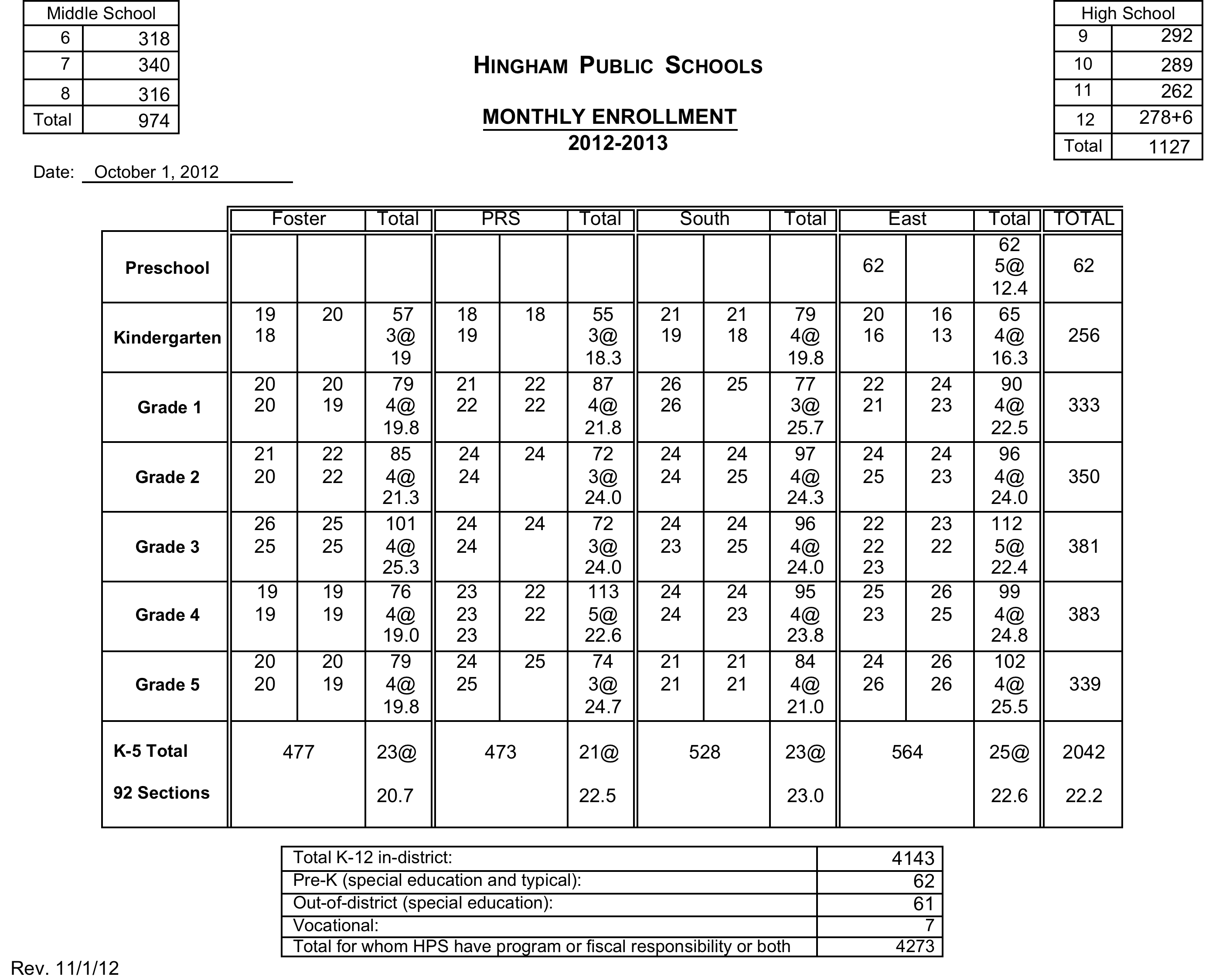

Slide 21
100 additional students
(11.4%)
vs
8 core subject sections
(3.9%)

Slide 23
Restoration of Needed Positions Or Services
These roles and services existed formerly, but have been cut or reduced over the past 5 years (some when the proposed operating budget override request was reduced in Spring 2009). Positions are necessary to the effective and efficient operation of the schools; enrollment and other needs have increased since 2009.
0.5 middle school librarian $30,302
1.0 middle school technology specialist $56,107
0.6 K-12 mathematics director (full time) $61,849
2.0 elementary assistant principals $190,332

Slide 24
(restoration continued)
1.0 PRS special education $61,034
1.0 custod./mainten. support/supervisor $65,000
additional college helpers (3) for summer maintenance/custodial work $12,650
30 hrs./wk. for the high school postsecondary support center $18,348
Total in Restoration category = $495,622

Slide 25
Initiatives to Enhance Programs
These resources are needed to incorporate pilot programs and to provide better support for existing programs and facilities.
HS Global Citizenship Program
leader and advisor stipends (prior HEF funding) $6,200
Freshman Advisory Program
teacher advisor stipends (prior volunteer) $7,585
HS Language Lab
lab aide hours (+ 5 hrs/wk) $3,058
General equip., copier, maintenance
increased funding levels $27,000
Total in Enhanced Programs category = $43,843

Slide 26
Areas of Unique Need
Includes responding to: state and federal mandates, changing student demographics, and social/emotional and health needs
Central office -.5 clerical support $14,611
Transition room tutor (27.5/wk) $27,723
HS health aide increase (+ 5hrs/wk) $3,058
Algebra II support – teacher stipends $2,400
Title IX clerical support $3,000
Title IX dance team coaches $3,108
Total in Unique Need category $53,900

Slide 27
DOLLAR BREAKDOWN OF “INITIATIVES”
BY LEVEL

Slide 29
Justified Needs, but NOT in Proposed Budget at this time
Restoration of 2.25 MS and elem. adjustment counselors ($142,768)
Additional 1.0 elem. teacher to mitigate large class sizes ($53,806)
Additional aide/para hrs (each 7.5/wk): HS health room and lang. lab ($4,587)
0.6 elementary reading evaluator ($51,748)
Additional tutor hours (7.5/wk) for transition room program ($5,545)
Text, instruct. materials, equip., mainten. projects
($100K estimate)
Total: requests not included ($358,484)
Notes:
THESE ARE REASONABLE REQUESTS!!!!!
THE SC IS ASKED TO LOOK ESPECIALLY AT THEM!!
THE FILTER HERE IS WHAT IS NEEDED, WHICH MAY NOT ALWAYS BE WHAT IS AFFORDABLE. WE DO UNDERSTAND THAT!!!
2 APS
ROUTINE SCHOOL MANAGEMENT
NEEDED FOR UPCOMING EVAL
BENEFIT IN SPED MEETINGS AND PARENT MEETINGS
INCREASING MANDATES SUCH AS COMMON CORE, BULLYING, ETC.

Slide 30
BUDGET FORMAT
FY 2014
Several Objects under each Function
34 Functions
(16 on January 10 and 18 on January 17)
Similar numbering of Objects
B Functions for Special
Education
E Functions for Voc. Ed.
One “other” Function
Object 1
Personnel
Object 2
Object 3
Support
Object 4
Supplies and materials
Etc.

Slide 31
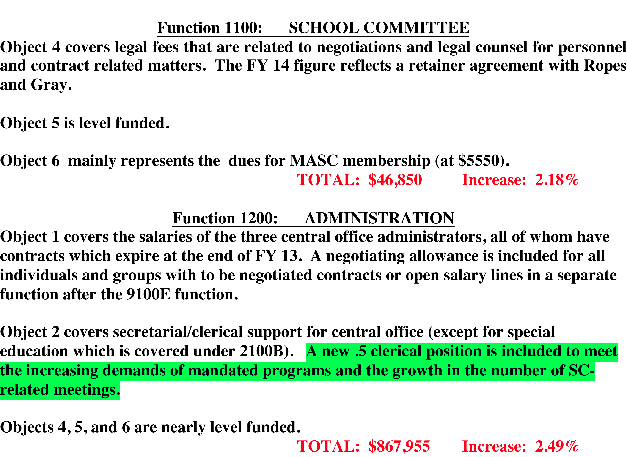

Slide 32
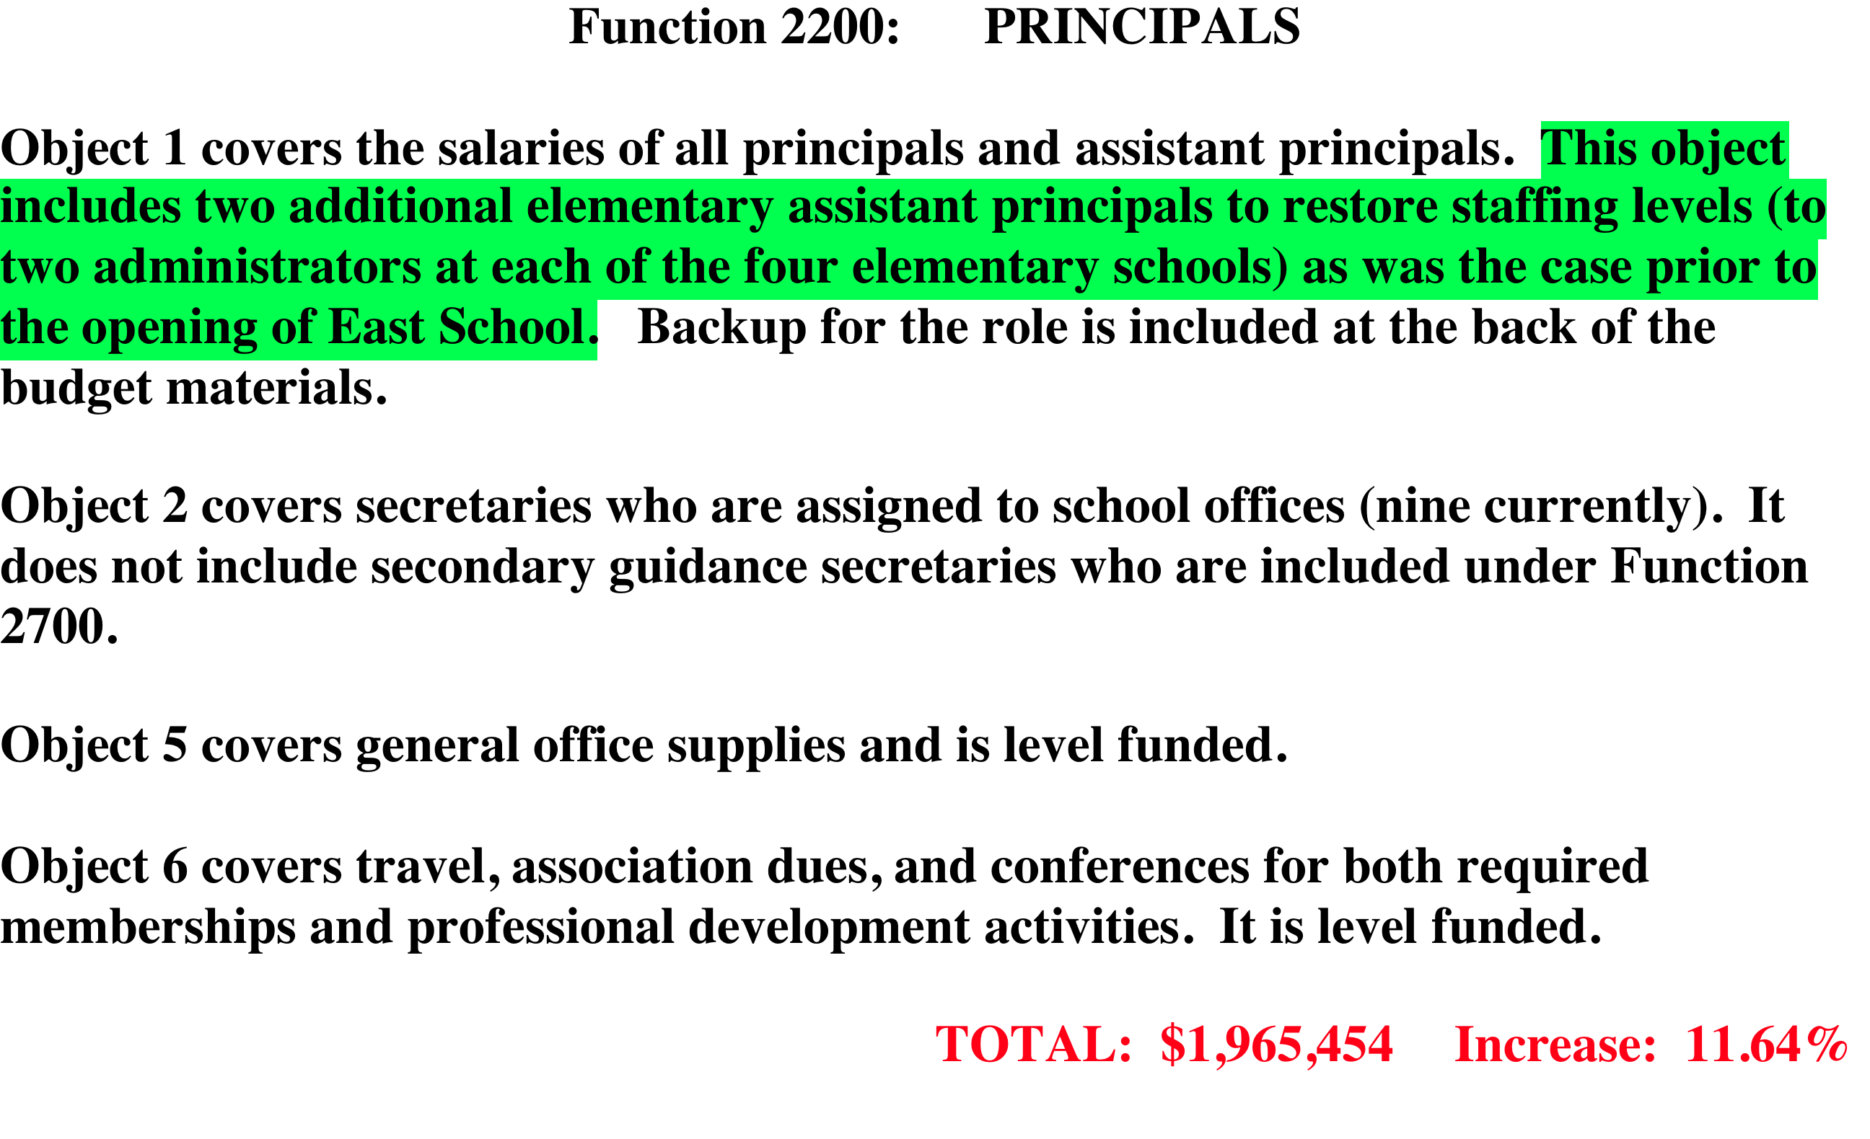

Slide 33
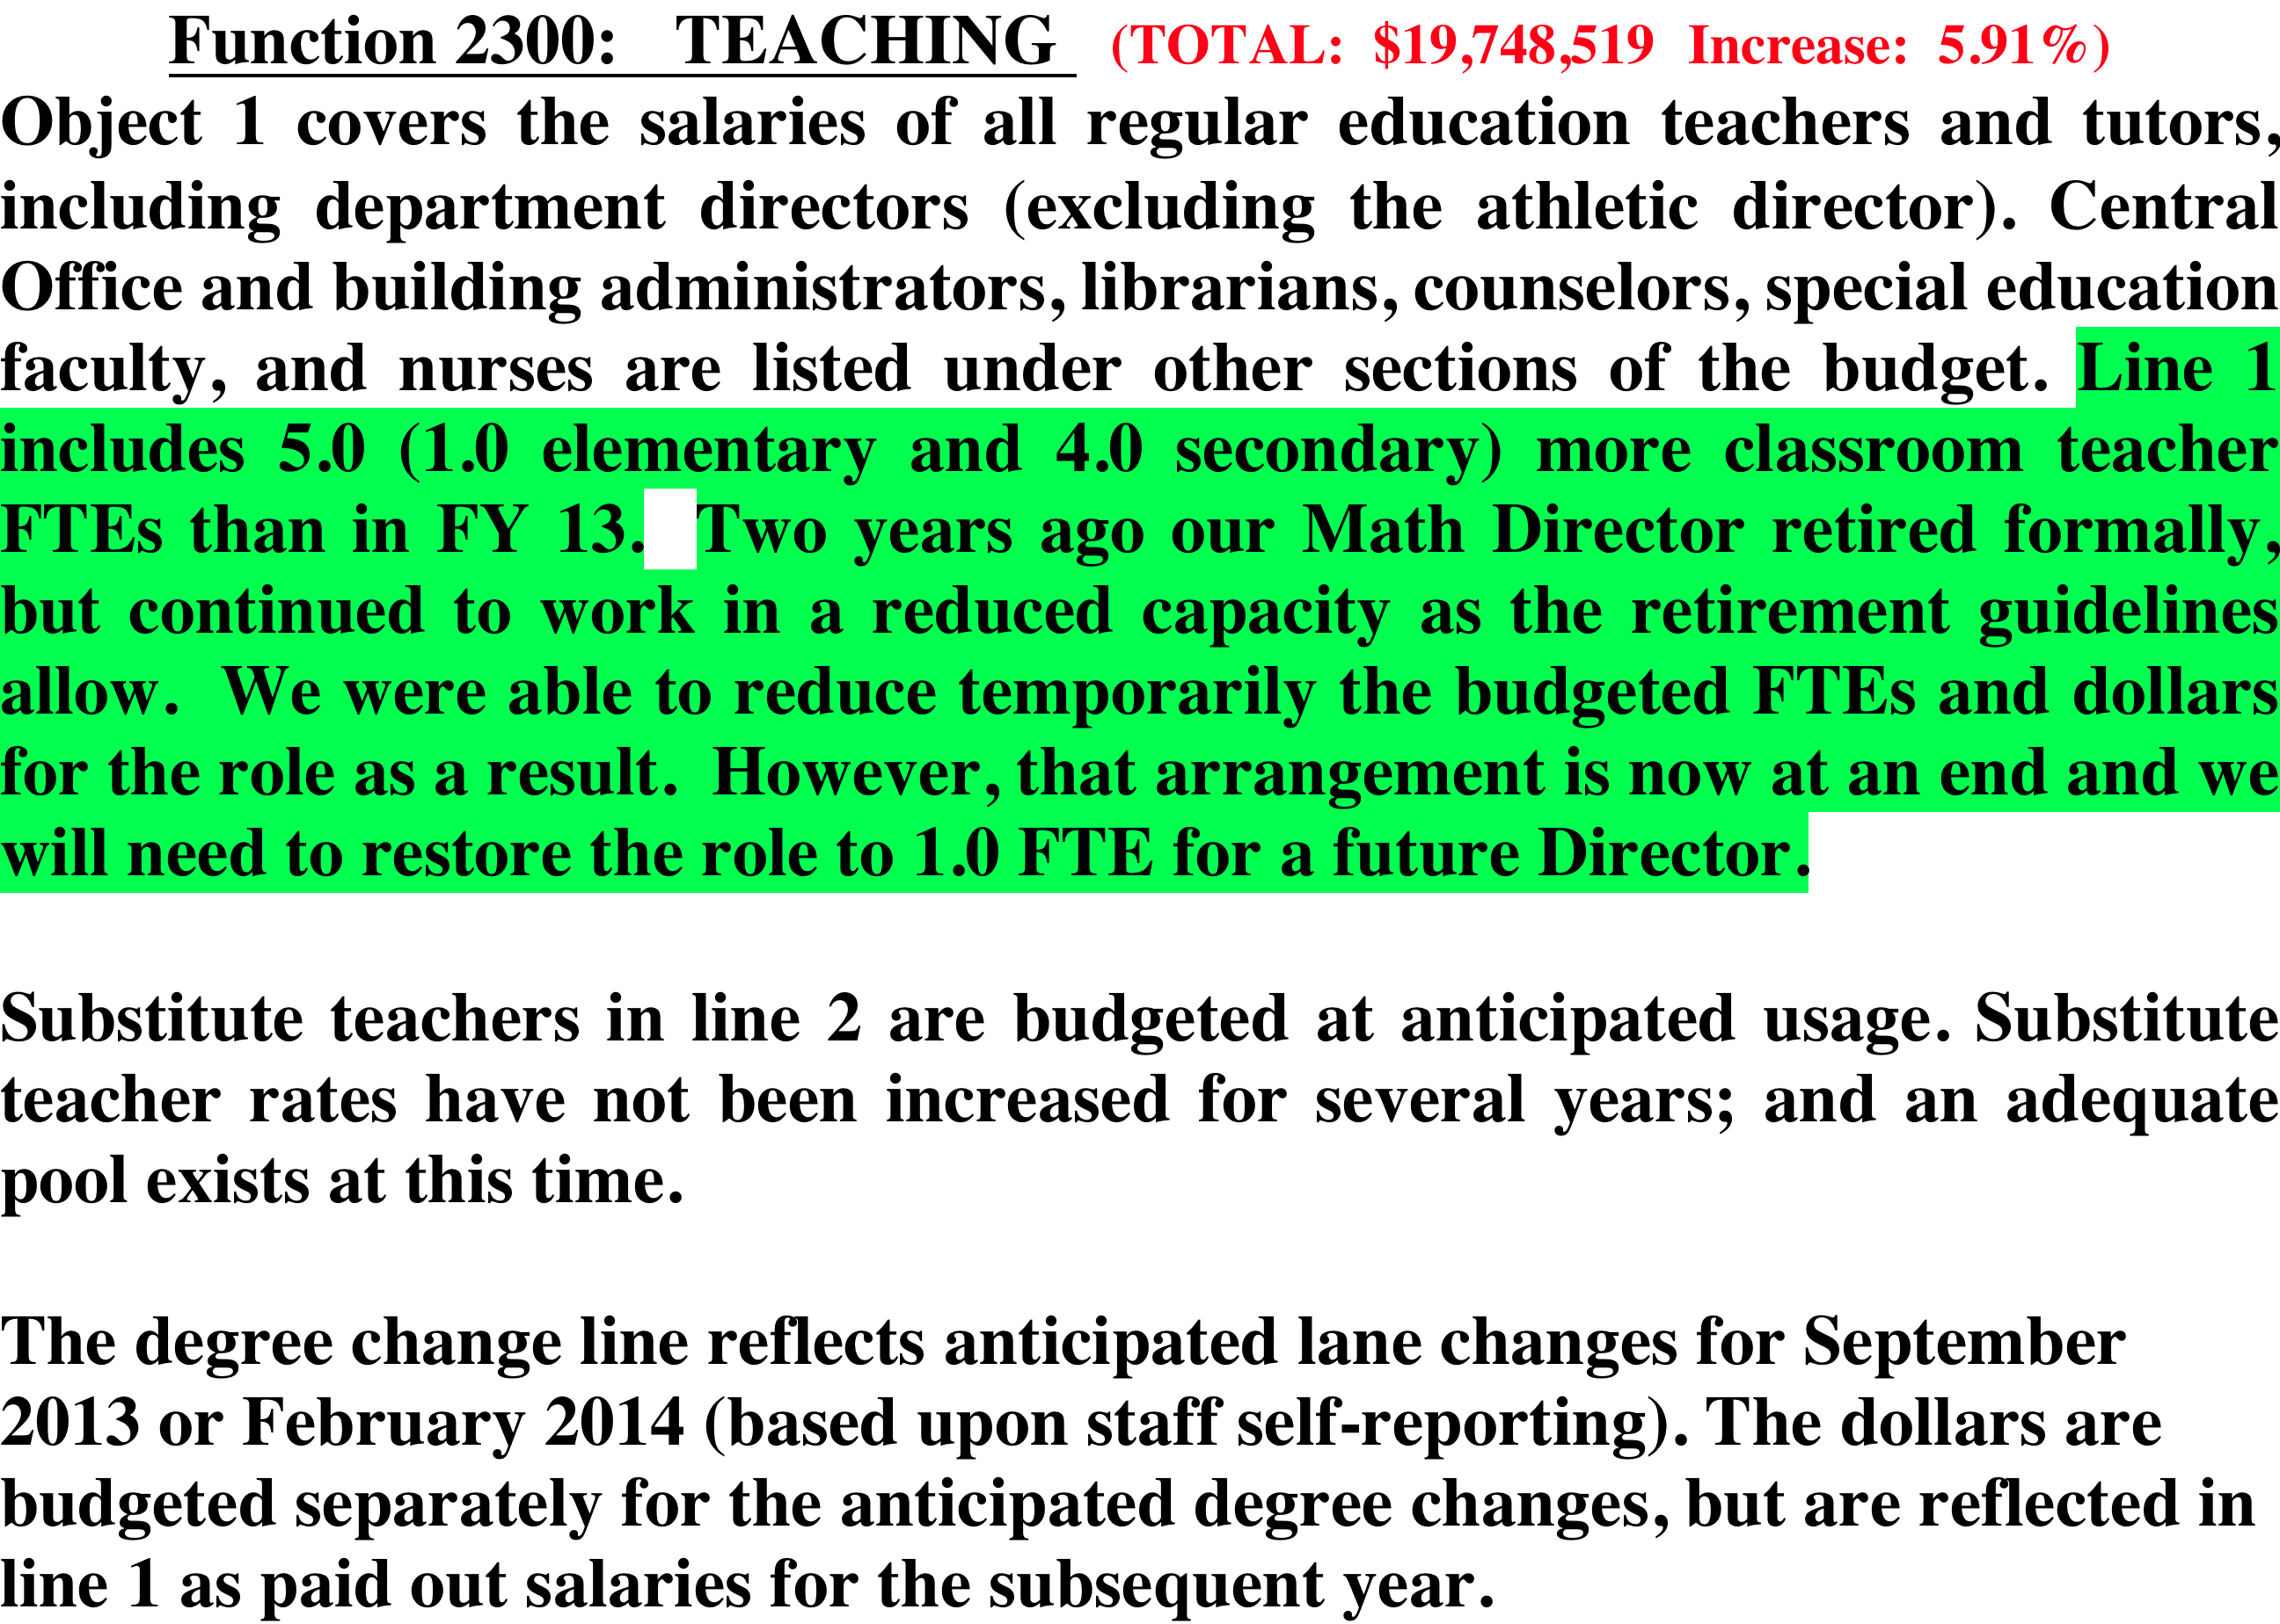

Slide 36
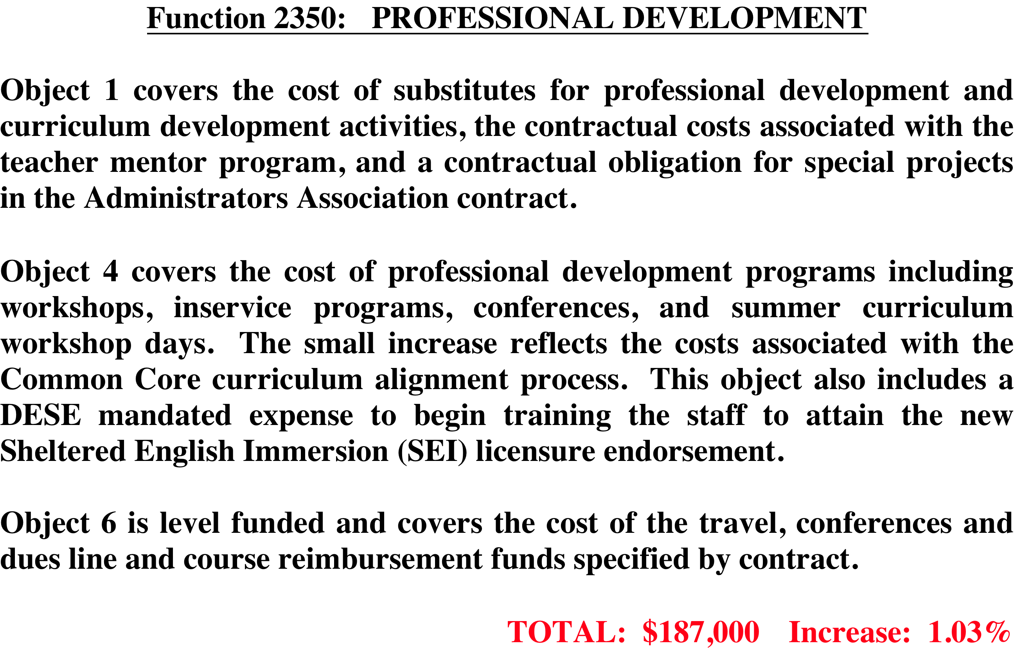

Slide 38
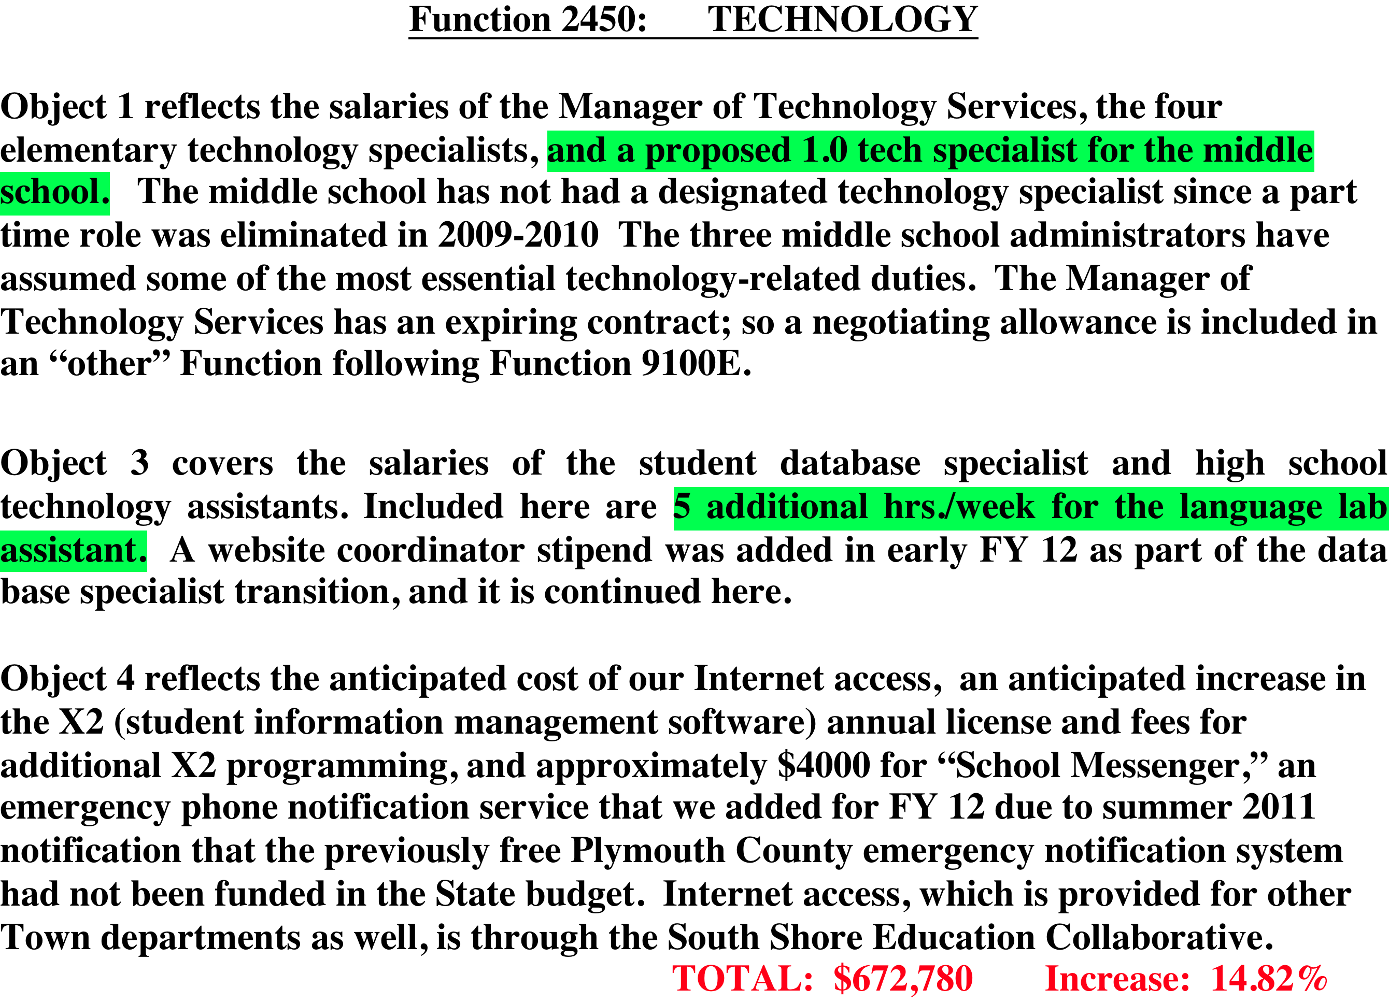

Slide 43
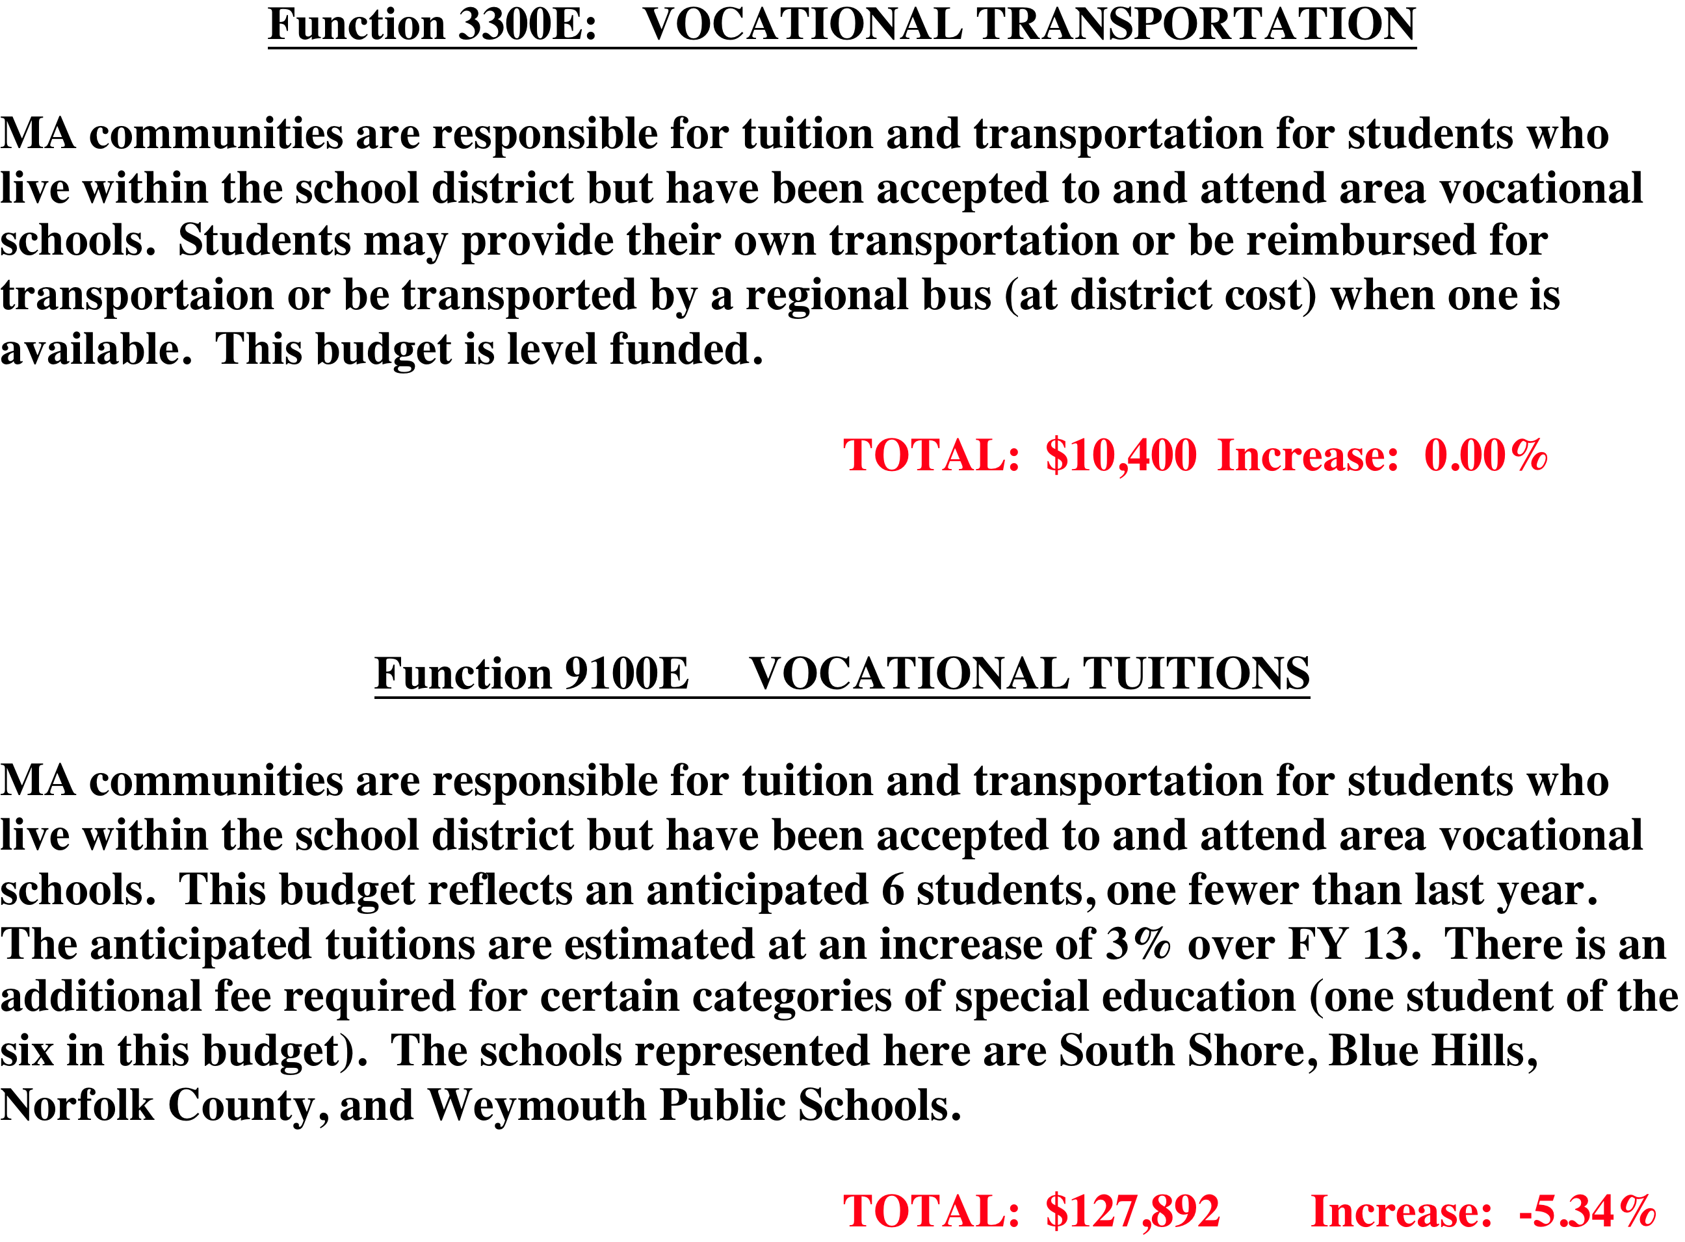

Slide 45
NEXT STEPS
Final presentation on budget detail (January 17)
School Committee’s initial discussions and prioritizing of requests (January 24)
Presentation to Joint Meeting of Selectmen and AdCom (January 31)
Formal Public Hearing on Budgets (February 11)
School Committee adoption of its budgets (February 11 or later)
Selectmen and AdCom vote on budgets to be recommended to Town Meeting (TBD)
Town Meeting vote on Article 6 -Town Budgets
(April 22)
Notes:
LOT TO DO IN SHORT TIME!!!!!
COUPLE OF OTHER ANTICIPATED MEETINGS (ADCOM SUBCOMMITTEE) NOT YET ON THE SCHEDULE
INFO ON WHICH FUNCTIONS ARE SCHEDUED ON WHICH THURSDAY IS IN YOUR PACKET

Slide 46
