Slide 1
School Budget Presentation to BoS and Advisory
January 31, 2013
Notes:
Good Evening. Before I hand this over to Dr. Galo for her presentation of the administration’s budget, I would like to take a few minutes to review a few points. Last year I stood before you and talked about the importance of splitting up the Special Education Budget from the Regular Education budget. The swing you will see this year in the Special Ed spending further emphasizes the unpredictability of this budget. Last year, I also spoke to you of the unfunded mandates, that continue to present pressures - these two items alone present unique budgeting ramifications- making the school budget different from other town budgets.

Slide 2
Guiding Principles
The recommended budget will:
reflect the district mission and community expectations for excellence and respond to identified needs resulting from enrollment growth, increased mandates, and special education costs, while acknowledging fiscal realities, competing priorities, and other Town-wide needs.
include funding requests which are necessary to address areas that have not kept pace with increased demands such as those above and include professional staffing, clerical and administrative support and technology requirements.
reflect contractual obligations as we know them, professional development and requirements, and staff supervision and support provisions to further the district’s goal of attracting, developing, and maintaining a highly qualified and adequately supported faculty and staff.
Notes:
For the last several years the budget was built based on anticipated revenues. This year we have changed that. Back in September, the SC meet on a Saturday and came to the agreement that our budget should be needs based. WE need to share and document the budget requests that come in from our Administration- funds that they feel they need to support a school system that Hingham Residents expect and desire, and that will continue to attract and retain the best educational talent we can.
The guiding principals that we agreed to and then requested that the Administration budget to are as follows:

Slide 3
Guiding Principles
The recommended budget will:
provide funding to meet state and federal mandates and DESE regulations, including those related to the special education and ELE laws, MA Accountability Standards, Common Core curriculum adoptions, and the new Educator Evaluation Standards, will be incorporated into the recommended budget.
include proposals for funding maintenance of, and capital improvements to, school buildings and properties and acquisition or replacement/upgrading of specialized equipment and technology enhancements.
will provide adequate funding for projected utilities/energy costs and for contracted services, such as for transportation and preventive maintenance.
will responsibly develop and reflect consideration of cost effective approaches to acquiring, managing resources and will include appropriate documentation of both needs and proposed solutions.
Notes:
As I am sure you can imagine, it was not easy to get 7 people to agree on all the guiding principles. We had great debate and discussion and “wordsmithing”. However, in the end, we felt that these principles accurately reflect and the needs and wants of the parents of the children in Town. Hingham is a great town to raise your children in- we have a beautiful town, that is well maintained by our DPW, protected by our excellent police and fire departments and provides an excellent education- at a fair cost.

Slide 4
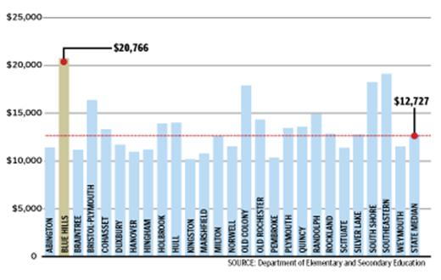
Boston Globe
Notes:
Hingham spending per pupil $11,213, 12% below the state median of $12,727

Slide 5
Percent of 2012 AP Grades *3 and Higher
*AP Exams are scored on a scale of 1-5
Notes:
Other great news is that we are continuing to see our students preform well on AP exams- well above the National average and impressively high within the State of Massachusetts.

Slide 6
2012 AP Scholar Designations
AP Scholars are designated in recognition of their exceptional achievement on the college level Advanced Placement (AP) examination. Nationally only
19% of the more than 1.9 million students who took AP exams in May 2012 performed at a sufficiently high level to merit such recognition. In Hingham, 39% of the 187 candidates were so honored.
Year | AP Scholar Award | AP Scholar with Honor | AP Scholar with Distinction | AP National Scholar
2012 | 25 | 20 | 24 | 3
2011 | 28 | 16 | 19 | 1
2010 | 19 | 15 | 13 | 1
2009 | 25 | 15 | 15 | 1
2008 | 22 | 14 | 18 | 2
2007 | 17 | 15 | 26 | 1
2006 | 18 | 10 | 12 | none
2005 | 21 | 5 | 17 | none
2004 | 15 | 10 | 14 | none
2003 | 17 | 7 | 7 | none
2002 | 15 | 15 | 2 | none
2001 | 10 | 9 | 3 | none
2000 | 16 | 6 | none | none

Slide 7
Summary of Plans Class of 2012
Notes:
As you know, The mission of Hingham High School is to graduate students with the academic, civic, social, and personal skills necessary to become productive, responsible members of a democratic and ever-changing global society. With a total percentage of 94% of our students continuing on to college- you can see we are succeeding in that mission. However, I am here to tell you, that we need to reconsider some of the decisions we have made in the past years. WE have not added to staff to meet the increasing student population, we need to reinstitute full time Assistant Principals in the elementary schools- , we need to add a bus, and therefore one bus driver, we need to return to needs based budgeting in order to continue to provide the excellent education that the town expects and wants for our children.
As always we will work with you to find a mutually acceptable balance between the towns resources and the schools needs.
Before I turn it over to Dr. Galo, I would like to Thank her, John Ferris, Ellen Keane, Liz Flynn, the Principals and their staffs for all the time and effort they dedicated to preparing the budget. It is a thoughtful and well-prepared budget and I appreciate the time you took to reengineer the budget process to meet our requests.
Thank you.

Slide 8
HINGHAM PUBLIC SCHOOLS
FY 2014 OPERATING AND CAPITAL BUDGET RECOMMENDATIONS January 31, 2013
JOINT MEETING PRESENTATION

Slide 9
FY 2014 ADMINISTRATION - PROPOSED BUDGET
“AT A GLANCE”
Combined Budgets $42,568,038
( + 4.93 % from FY ’13)
Regular Education $31,864,872
( + 6.49 % from FY ‘13)
Special Education $10,564,875
( + 0.63 % from FY ‘13)
Vocational Education $138,292
( - 4.96 % from FY ’13)
Initial Request
Dec. 2012

Slide 10
FY 2014 ADMINISTRATION’S PROPOSED BUDGET
“AT A GLANCE” – 1/24/13 Revision
Regular Education $31,864,872 $31,755,597
( + 6.49 % + 6.12% from FY ‘13)
Special Education $10,564,875 $10,410,115
( + 0.63 % - 0.84% from FY ‘13)
Vocational Education $138,292 (no change)
( - 4.96 % from FY ’13)
Com
Combined Budgets $42,568,038 $42,304,003
( + 4.93 % + 4.28% from FY ’13)

Slide 11
FY 2014 ADMINISTRATION - PROPOSED BUDGET
“AT A GLANCE”
Combined Budgets $42,224,716
( + 4.09 % from FY ’13)
Regular Education $31,676,310
( +5.86% from FY ‘13)
Special Education $10,410,115
( - .84% % from FY ‘13)
Vocational Education $138,292
( - 4.96 % from FY ’13)
January 31 Revision
( - $79,287)

Slide 12
CHANGES TO ADMINISTRATION’S PROPOSED FY 14 BUDGET as of 1/31/13
Personnel changes – 3 retirements, 1 LOA, other adjustments - $173,592
2500 Cable offset, HS para hrs. career center (-5) and library (-13) - $32,171
3510 Error correction - $1,833
4120 Increased building rental (15K) and KIA (10K) offsets - $25,000
4120 Increased natural gas (18,801) and oil (37,903) heating + $56,704
4130 Electricity price reduction - $25,610
5100 Adjusted retirement costs + $12,940
2100B Adjusted legal - $10,000
9100B reduce one anticipated tuition and one anticipated grad. - $144,760
Total Reduced $343,322

Slide 13
 |  |  | Original |  | Adjusted
 |  | Budget | Budget | Adjustment | Budget | Increase
ACCOUNT | ACCOUNT TITLE | 2012-2013 | 2013-2014 | 31-Jan-13 | 24-Jan-14 | (Decrease)
1100 | School Committee | $45,850 | $46,850 |  | $46,850 | $1,000
1200 | Administration | $846,853 | $867,955 |  | $867,955 | $21,102
2200 | Principals | $1,760,477 | $1,965,454 |  | $1,965,454 | $204,977
2300 | Teaching | $18,645,917 | $19,748,519 | -$173,592 | $19,574,927 | $929,010
2350 | Professional Development | $185,100 | $187,000 |  | $187,000 | $1,900
2400 | Textbooks | $237,137 | $264,066 |  | $264,066 | $26,929
2410 | Instructional Equipment | $11,500 | $22,700 |  | $22,700 | $11,200
2450 | Instructional Technology | $585,947 | $672,780 |  | $672,780 | $86,833
2500 | Library | $537,159 | $630,498 | -$32,171 | $598,327 | $61,168
2700 | Counseling | $876,234 | $952,457 |  | $952,457 | $76,223
2800 | Psychological Services | $329,464 | $339,448 |  | $339,448 | $9,983
3200 | Health Services | $477,485 | $492,100 |  | $492,100 | $14,615
3300 | Transportation | $1,236,613 | $1,286,998 |  | $1,286,998 | $50,384
3510 | Athletics | $595,919 | $595,890 | -$1,833 | $594,057 | ($1,862)
3520 | Other Student Activity | $94,706 | $103,041 |  | $103,041 | $8,335
4110 | Custodial | $1,329,369 | $1,417,918 |  | $1,417,918 | $88,549
4120 | Heating of Buildings | $458,369 | $392,002 | $31,704 | $423,706 | ($34,663)
4130 | Utilities | $732,145 | $749,943 |  | $749,943 | $17,798
4210 | Maintenance of Grounds | $13,478 | $27,108 |  | $27,108 | $13,630
4220 | Plant Maintenance | $718,640 | $751,126 | -$25,610 | $725,516 | $6,877
4230 | Repairs of Equipment | $107,370 | $106,053 |  | $106,053 | ($1,317)
5100 | Employee Retirement | $75,792 | $29,231 | $12,940 | $42,171 | ($33,621)
7000 | Non-Instructional Equipment | 0 | 0 |  | $0 | $0
 | Allowance for increases | $21,671 | $215,736 |  | $215,736 | $194,065
 | Total Regular Education | $29,923,194 | $31,864,872 | -$188,562 | $31,676,310 | $1,753,115 | 5.86%

Slide 14
 |  |  | Original |  | Adjusted
 |  | Budget | Budget | Adjustment | Budget | Increase
ACCOUNT | ACCOUNT TITLE | 2012-2013 | 2013-2014 | 31-Jan-13 | 24-Jan-14 | (Decrease)
2100B | Sped Supervision | $238,244 | $242,314 | -$10,000 | $232,314 | ($5,930)
2300B | Sped Instruction | $5,457,819 | $5,692,823 |  | $5,692,823 | $235,004
2350B | Sped Prof. Development | $10,700 | $9,900 |  | $9,900 | ($800)
2400B | Sped Textbooks | $900 | $900 |  | $900 | $0
2700B | Sped Counseling | $388,316 | $403,720 |  | $403,720 | $15,404
2800B | Sped Psychological Services | $231,753 | $245,277 |  | $245,277 | $13,524
3300B | Sped Transportation | $627,287 | $569,553 |  | $569,553 | ($57,734)
9100B | Sped Prog w/other Districts | $3,543,599 | $3,400,388 | -$144,760 | $3,255,628 | ($287,971)
 | Total Special Education | $10,498,618 | $10,564,875 | -$154,760 | $10,410,115 | ($88,504) | -0.84%
3300E | Vocational Transportation | $10,400 | $10,400 |  | $10,400 | $0
9100E | Vocational Tuition | $135,108 | $127,892 |  | $127,892 | ($7,216)
 | Total Votech | $145,508 | $138,292 |  | $138,292 | ($7,216) | -4.96%
 | Total Proposed Budget | $40,567,321 | $42,568,038 | -$343,322 | $42,224,716 | $1,657,395 | 4.09%

Slide 16
376
356
342
333
319
297

Slide 18
K – 12 Projections for September 2014 (based on moving along December 2012 actuals)
Grades K – 5
2041 -339 (to gr. 6) + 256 (new K) + 60 (grade K to 1 growth) = 2018
Down 23, plus net in/out migration
Grades 6-8
974 - 316 (to HS) + 339 (from grade 5) = 997
Up 23, plus net in/out migration
Grades 9-12
1127 + 316 (from grade 8) – 276 (graduates) = 1167
Up 40, plus net in/out migration
Projections assume no net in/out-migration, so are conservative based upon past practice of at least some net increases.
4182
PROJECTED
K-12 TOTAL
Notes:
OUR INTERNAL PROJECTS FOR EACH BUDGET YEAR FOLLOW A SIMPLE STRATEGY.
PROJECT K NUMBER,
PROJECT INCREASE TO GRADE 1,
AND MOVE EVERYONE ELSE ALONG (all real kids).
ASSUME, BUT DO NOT QUANTIFY IN AND OUT MIGRATION
LAST 3 YEARS, GRADE K TO 1 HAS AVERAGED MORE THAN 40

Slide 19
WHAT IS A “NEEDS - BASED” BUDGET?
A proposal from the administration to the SC that reflects needs and priorities as identified by Principals, Directors, and Central Office
One that includes costs that are known or projected based upon current information
One that results from enrollment increases or new or emerging needs or a backlog of needs reflecting prior cuts or underfunding
The beginning of the conversation

Slide 20
FY 14 Budget Budget Offsets (Gross and Net Budgets) Based on Initial December Budget

Slide 21
Enrollment Related Requests Requests reflect both anticipated enrollment for September 2013 and underfunding of prior year needs as enrollments have grown.
1.0 K-5 teacher $51,583
4.0 gr. 7-12 teachers (core
subjects and electives) $231,572
additional bus and driver $46,809
assistant X-country coach $1,623
assistant sailing coach $1,623
Total in Enrollment Related = $333,210

Slide 22
Restoration of Needed Positions or Services
These roles and services existed formerly, but have been cut or reduced over the past 5 years (some when the proposed operating budget override request was reduced in Spring 2009). Positions are necessary to the effective and efficient operation of the schools; enrollment and other needs have increased since 2009.
0.5 middle school librarian $30,302
1.0 middle school technology specialist $56,107
0.6 K-12 mathematics director (full time) $61,849
2.0 elementary assistant principals $190,332

Slide 23
(restoration continued)
1.0 PRS special education $61,034
1.0 custod./mainten. support/supervisor $65,000
3 additional college helpers for summer mainten./custodial work $12,650
30 25 hrs./wk. for the high school postsecondary support center $18,348 $15,290
Total: Restoration category = $495,622 $492,564

Slide 24
Initiatives to Enhance Programs These resources are needed to incorporate pilot programs and to provide better support for existing programs and facilities.
HS Global Citizenship Program
leader and advisor stipends (prior HEF funding) $6,200
Freshman Advisory program
teacher advisor stipends (prior volunteer) $7,585
HS Language Lab
lab aide hours (+ 5 hrs/wk) $3,058
General equip., copier, maintenance
increased funding levels $27,000
Total in Enhanced Programs category = $43,843

Slide 25
Areas of Unique Need Includes responding to: state and federal mandates, changing student demographics, and social/emotional and health needs
Central office -.5 clerical support $14,611
Transition room tutor (27.5/wk) $27,723
HS health aide increase (+ 5hrs/wk) $3,058
Algebra II support – teacher stipends $2,400
Title IX clerical support $3,000
Title IX dance team coaches $3,108
Total in Unique Need category $51,500

Slide 26
ADDITIONAL FTEs by CATEGORY
*Professional Staff
Admin. Elem. APs 2.0 Math DH 0.6
Classroom teachers 5.0
(MS & HS 4.0, Elem. 1.0)
Tech Specialist MS 1.0
Library/Media MS 0.5
Spec. Ed. PRS 1.0
*(of which 4 FTEs extend the time of existing positions)
Support Staff - Salaried
Sec./Clerical C.O. 0.5
Bus Driver (new bus) 1.0
Custodial/Superv. 1.0
Support Staff – Hourly
Paras and tutors/wk. 62.5
(transition tutor, college career aide, lang. lab, health aide)
Other Stipended (PT)
(summer college help 3, coaches 3)

Slide 28
Justified Needs, but NOT in Proposed Budget at this time
Restoration of 2.25 MS and elem. adjustment counselors ($142,768)
Additional 1.0 elem. teacher to mitigate large class sizes ($53,806)
Additional aide/para hrs (each 7.5/wk): HS health room and lang. lab ($4,587)
0.6 elementary reading evaluator ($51,748)
Additional tutor hours (7.5/wk) for transitional room program ($5,545)
Text, instruct. materials, equip., mainten. projects
($100K estimate)
Total: requests not included ($358,484)
Notes:
THESE ARE REASONABLE REQUESTS!!!!!
THE SC IS ASKED TO LOOK ESPECIALLY AT THEM!!
THE FILTER HERE IS WHAT IS NEEDED, WHICH MAY NOT ALWAYS BE WHAT IS AFFORDABLE. WE DO UNDERSTAND THAT!!!
2 APS
ROUTINE SCHOOL MANAGEMENT
NEEDED FOR UPCOMING EVAL
BENEFIT IN SPED MEETINGS AND PARENT MEETINGS
INCREASING MANDATES SUCH AS COMMON CORE, BULLYING, ETC.

Slide 30
SPECIAL DUCATIN BUDGET AS % OF TOTAL SCHOOL OPERATING BUDGET
FY ’98 TO FY ’13
Fiscal Year % of Total Operating Circuit Breaker
FY 98 15.7%
FY 99 16.8%
FY 00 17.8%
FY 01 17.1%
FY 02 17.7%
FY 03 19.0%
FY 04 20.1% 125,804
FY 05 20.9% 150,000
FY 06 20.6% 589,384
FY 07 20.6% 556,912
FY 08 22.5% 641,777
FY 09 23.3% 607,366
FY 10 23.3% 845,081
FY 11 21.5% 513,039
FY 12 24.6% 438,670
FY 13 (proposed) 25.1% 767,625
(Budget figures are net of grants and offsets, including Circuit Breaker)

Slide 31
SPECIAL EDUCATION ENROLLMENT January 2013 “Snapshot”
By Level (In + Out of District)
By Building
Pre-K 35 + 2
Elem. K-5 211 + 16 + (1#)
MS 6-8 150 + 15 + (2#)
HS 9-12+ 152 + 29 + (3#)
TOTALS 548 + 62 + (6#)
610
# NON-SPED PRIVATE SCHOOL, BUT SERVICE ELIGIBLE
EAST 60 K-5 + 35 PK
FOSTER 55 K-5
PRS 54 K-5
SOUTH 42 K-5
MS 150 6-8
HS 147+5 9-12+
TOTAL 548

Slide 32
FY2014 - Special Education Staffing
FTEs under 2300 B
FTEs in other functions
3.0 Pre-K (E) 3.0 Ext K. (E,S)
4.O Foster (K-5) 4.0 PRS* (K-5)
4.0 East (K-5) 4.0 South (K-5)
7.0 MS (6-8) 7.0 HS (9-12+)
5.0 Speech/Lang.** (see CS)
2.0 Occup. Therapy
5.8 Reading
Support
Para-educators, tutors, building clerical (hourly)
(* includes 1.0 new)
2100B Director 1.0
2100B C.O. Clerical 1.85
2700B Elem. Psych./Chairs (4.0)
2700B E. Childhood Coord. (.7)
2800B Sec. Psychologists (2.5)
Contracted Services (CS)
English Support Tutor, ASL Interpreter (2), Phys. Ther.(1),
ABA Spec.( PT), O of D Coord. (PT), **Sp./Lang. (PT)

Slide 36
Out of District *Tuitions (2013-2014, projected for 66 students)
Type of School
*Tuition Range
Private Day Schools (12)
Private Residential Schools (11)
SEIS (Public) Residential (2)
Other Public Schools (5)
South Shore Educ. Collab. (26)
Other Local Collaboratives (10)
*Tuitions include known increases and projections for OSD requested increases. Some tuitions are for year-round services.
$ 40,492 to $ 106,000
$ 69,812 to $ 213,570
Deducted from Chapter 70
$ 32,270 to $ 42,700
$ 32,270 to $ 56,120
$ 29,750 to $ 56,650
SEIS - Special Education in Institutional Settings(add’ services only)
OSD – Operational Services Division

Slide 37
FY 2014 ADMINISTRATION - PROPOSED BUDGET
“AT A GLANCE”
Combined Budgets $42,224,716
( + 4.09 % from FY ’13)
Regular Education $31,676,310
( +5.86% from FY ‘13)
Special Education $10,410,115
( - .84% % from FY ‘13)
Vocational Education $138,292
( - 4.96 % from FY ’13)
January 31 Revision
( - $79,287)

Slide 38
NEWER $$$ MANDATES: The “Heavy Hitters”
HB# 4307 Background Checks: FINGERPRINTING of EDUCATORS
Sept ‘13 – ’15 Recordkeeping and process costs ($35 -$55 per educator)
C.222 - Acts of 2012 School Discipline: ACCESS FOR EXCLUDED STUDENTS
July 2014 Tutoring?, e- courses?, OoD placement?, alternative programs? – Increased planning and support activities for counselors and administrators
PARCC ASSESSMENT Online Testing: SUCCESSOR TESTING TO MA MCAS
Spring 2015 Costs of enhanced technology resources (computers,
(initial testing) Internet access, band width, headsets and microphones)
DESE/RETELL Licensure Endorsements: SEI TRAINING FOR TEACHERS
thru 2016 & SUPERVISORS of ELL (English Language Learner) STUDENTS (staggered) Costs related to mandated training and eligibility changes
Other Potential Costs: Title IX Compliance, Coordinated Program Review Compliance, Additional school security measures, etc.

Slide 39
STRATEGIES FOR SAVINGS AND EFFICIENCIES
Strategy
Impact
Lease vs purchase of copiers
Electronic school to home communication
Recycling and composting efforts
Direct deposit and “paperless payroll”
initiatives
Revised ordering protocols (school-based)
Standardizing para services across schools
Energy reduction and management projects
Savings in maintenance costs, less “down” time
Savings in paper, production and distribution of paper copy
Reduction in disposal costs and some revenue production
Better use of personnel, printing savings, more accurate reporting and recording
Reduced potential for overstocking, better inventory control
Savings in para hours/$ in regular education
Energy/$ savings in capital and in operating budgets

Slide 40
STRATEGIES FOR SAVINGS AND EFFICIENCIES
Strategy
Impact
Develop. of new ways to provide FAPE in- district such as thru new cohort groups, transition services etc.
Review of contracts for specialized services to negotiate better rates for special education services
“Cross training” of C.O. clerical staff
Minimizing hiring of substitutes for support roles, where possible
Cost savings and children served in least restrictive settings (ex.” in-district” intensive K and PK programs and return of OoD students to HPS)
Cost savings and improved service quality
Better management of resources to meet new demands and consistent coverage during times of absence
Cost savings

Slide 41
FY 14 SCHOOL CAPITAL REQUEST
Capital Outlay Request – School Needs
January 9, 2013 $1,267,074
Redistributed and Reduced – School Committee Meeting
January 24 $790,334
Further Redistributed/Refined/Reduced –Long Range Planning Sub Committee
January 30 $660,734

Slide 42
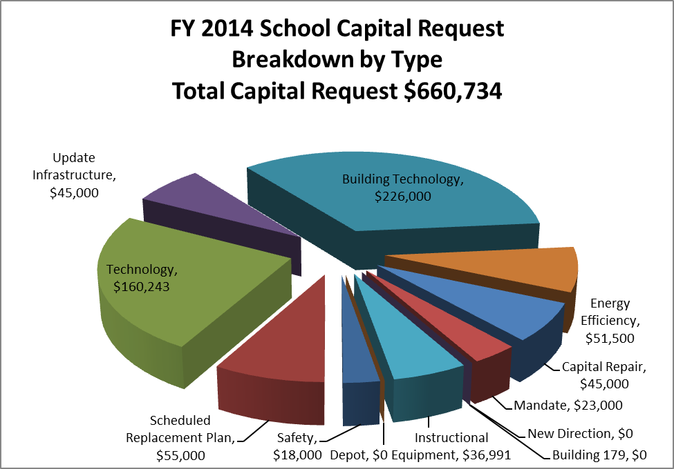

Slide 43
NEXT STEPS
Formal Public Hearing on Budgets (February 11)
Next meeting with Capital Outlay (TBD)
School Committee adoption of its budgets (February 25)
Education Subcommittee recommends School Budget to Ad Com (February 26)
Selectmen and AdCom vote on budgets to be recommended to Town Meeting (February 28?)
Town Meeting vote on Article 6 -Town Budgets
(April 22) YEAH!!!!!!
Notes:
LOT TO DO IN SHORT TIME!!!!!
COUPLE OF OTHER ANTICIPATED MEETINGS (ADCOM SUBCOMMITTEE) NOT YET ON THE SCHEDULE
INFO ON WHICH FUNCTIONS ARE SCHEDUED ON WHICH THURSDAY IS IN YOUR PACKET

